Slide 1

IBM University Engagement Project Submission
“Exploring the Power of Agentic AI with IBM Granite and LangFlow”

Slide 2



Project Title – [Challenge 9 – Smart Industrial Pollution Monitoring for Golden Corridor (Vapi– Ankleswar) ]
Domain of Project – Environmental Sustainability / Smart City / Industrial Safety / Agentic AI
Student Name | Recent Passport Photo | Email ID | Mobile number [WhatsApp]
Padia Bansari |  | bansaripadia2708@gmail.com | 7069670736
Gohel Tisha |  | tishagohel1999@gmail.com | 9909159972
Bhalara Harshdi |  | harshdibhalara@gmail.com | 9624077183

Slide 3





1. Problem Statement

Slide 4
Problem Statement – Industrial Pollution Monitoring
The Vapi–Ankleshwar–Vatva Golden Corridor has a high concentration of chemical, pharmaceutical and manufacturing industries, creating risks of air pollution, industrial effluents, chemical contamination, high COD/BOD, PM2.5/PM10, SO₂/NO₂, abnormal pH and high TDS.
Current monitoring often relies on periodic inspections and manual reporting, leading to delayed pollution detection, limited real-time visibility, difficulty monitoring multiple industries, slow regulatory response, manual compliance reporting and limited public-health risk assessment.
Therefore, an intelligent and continuous monitoring system is needed to detect pollution in real time, identify violations, assess risks and support faster regulatory action.

Slide 5

2. The Challenge /The Objective

Slide 6
Challenge 9: Smart Industrial Pollution Monitoring for Golden Corridor (Vapi–Ankleshwar)
Develop an intelligent system for the Vapi–Ankleshwar Golden Corridor that continuously monitors industrial air emissions and water effluents, detects abnormal pollution, identifies violations, assesses risk, and enables faster regulatory response.
Objective:
EcoGuard AI is an Agentic AI-powered platform designed to:
📡 Monitor real-time air & water sensor data
⚠️ Detect & classify pollution and violations
🚨 Generate real-time alerts & escalation
🏥 Assess environmental & public-health risks
🔍 Investigate pollution spikes
🤖 Assist authorities with AI insights
📄 Generate AI-powered compliance reports
💬 Answer queries through a natural-language AI assistant
📊 Visualize live pollution data & agent activities in one dashboard

Slide 7

3.Proposed Solution

Slide 8

Proposed Solution
🌱 EcoGuard AI
EcoGuard AI is a web-based Agentic AI platform that continuously monitors industrial pollution, detects violations, assesses risks, and supports faster regulatory action.
Flow:
📡 Sensor Data → Monitor → Detect → Analyze → Alert → Investigate → AI Report → Dashboard
Air Monitoring: PM2.5, PM10, CO, SO₂, NO₂, VOCs, AQI Water Monitoring: pH, COD, BOD, TDS, Temperature, Turbidity
🔄 Real-time sensor simulation generates Normal, Warning, High-Risk & Critical pollution scenarios.

Slide 9

4.Technology Used

Slide 10
Technology Used
Frontend: React.js, JavaScript, Axios, Chart.js, CSS, React Context API
Backend: Node.js, Express.js, REST APIs, JWT Authentication, bcrypt, Helmet, CORS, Morgan, Express Rate Limit
Database: NeDB, Users Database, Industries Database, Sensors Database, Readings Database, Violations Database, Alerts Database, Reports Database, Risk Assessments Database, Agent Activities Database
AI: IBM watsonx, IBM Granite LLM, AI-Generated Compliance Reports, Natural-Language AI Queries, AI Environmental Analysis
IoT: Real-Time Sensor Simulator, Air-Quality Sensors, Water-Quality Sensors
Security: JWT Authentication, Role-Based Access Control, bcrypt Password Hashing, Helmet Security Middleware, CORS Configuration, Rate Limiting

Slide 11

5.Langflow Components Used

Slide 12
Langflow Components Used
1) Chat/Input Component – Receives user queries related to pollution, industries, air quality, water quality, violations, and environmental risks.
2) API Request / HTTP Component – Connects Langflow with the EcoGuard backend to retrieve real-time sensor readings, violations, alerts, industries, and risk data.
3) JSON/Data Component – Processes structured pollution and sensor data received from the backend.
4) Prompt Template – Converts pollution data and user queries into structured prompts for AI analysis.
5) IBM watsonx AI Agent – Processes environmental data and user queries using IBM Granite to generate intelligent pollution insights and recommendations.
6) IBM Granite Model – Granite-4.0-8B-Instruct → Used for fast, efficient environmental analysis, natural-language responses, and AI-generated compliance reports.
7) Condition / Router Component – Classifies pollution conditions as Normal, Warning, High, or Critical and routes them to the appropriate agent/action.
8) Agent / Tool Component – Supports specialized agents for monitoring, violation detection, regulatory alerts, health-risk assessment, investigation, and dashboard intelligence.
9) Memory Component – Maintains relevant conversation/context information for continuous AI interaction.
10) Output Parser – Structures AI-generated analysis into readable results such as risk level, violation details, recommendations, and reports.

Slide 13

6.Langflow workflow

Slide 14
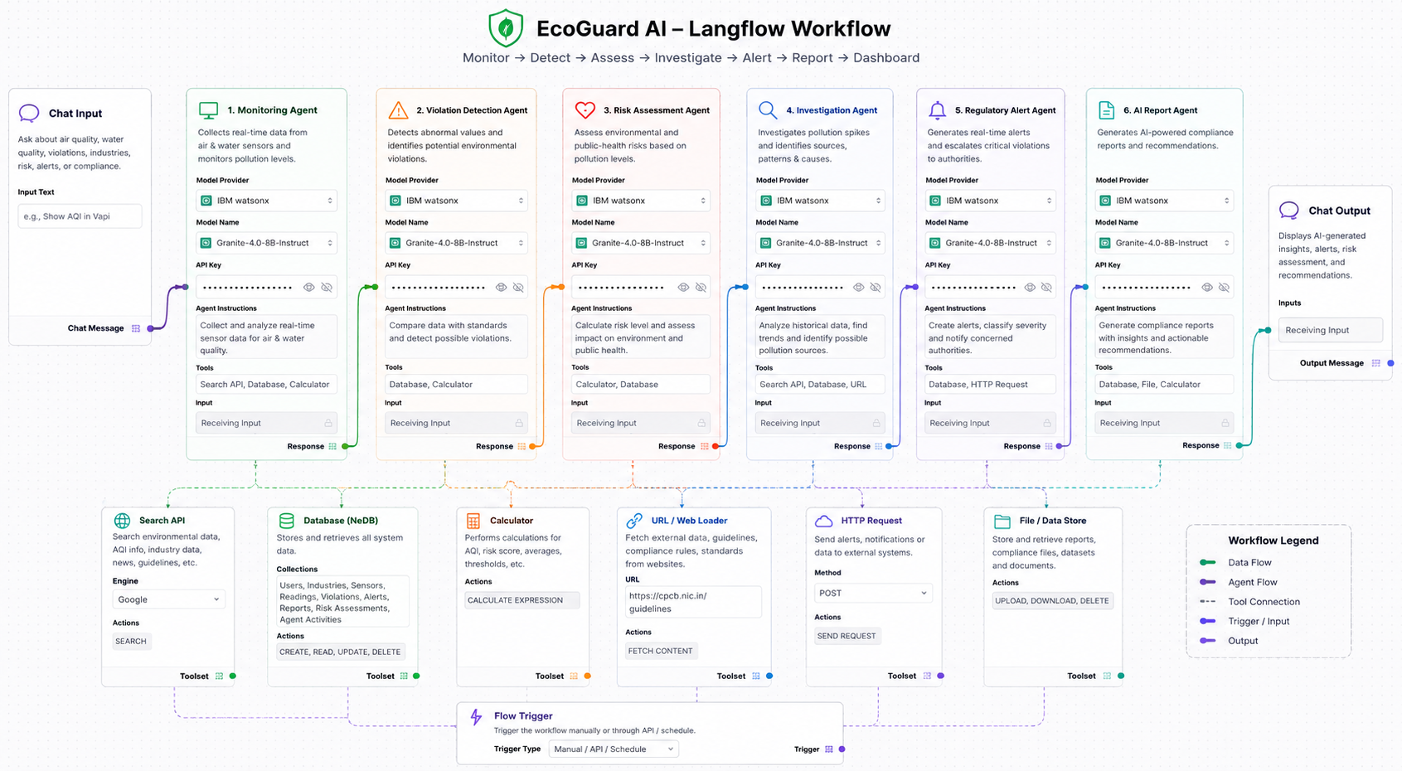

Slide 15

7.Architecture blueprint

Slide 16
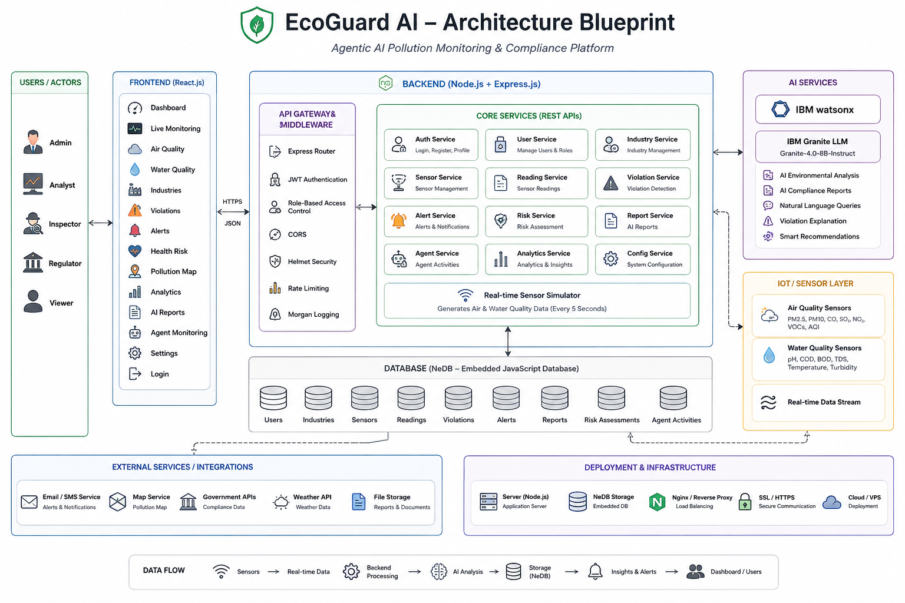

Slide 17

8.Role of Agentic AI in the solution

Slide 18
Role of Agentic AI in the solution
Agentic AI enables EcoGuard AI to function as an intelligent and proactive environmental monitoring system rather than a simple monitoring dashboard. Using IBM watsonx.ai and IBM Granite models, the system analyzes pollution data, detects violations, assesses risks, investigates pollution events, and supports regulatory decisions.
Each specialized agent performs a specific role—such as monitoring sensor data, detecting pollution violations, assessing environmental and health risks, investigating pollution sources, generating regulatory alerts, and creating AI-based compliance reports—while working together. This multi-agent approach enables efficient task execution and faster environmental decision-making.
Agentic AI provides context awareness by analyzing industry information, sensor readings, pollution levels, historical data, violation records, and risk assessments to generate relevant recommendations.
It also supports real-time adaptation, continuously analyzing new air and water sensor readings and responding when pollution levels change from normal to warning, high-risk, or critical conditions.
Additionally, the agents communicate and share information with each other, enabling a complete workflow:
Monitor → Detect → Assess → Investigate → Alert → Report → Act
Overall, Agentic AI makes EcoGuard AI proactive, intelligent, automated, and goal-driven, acting as a smart environmental monitoring and compliance assistant that helps industries and regulatory authorities detect pollution faster, assess risks, and take timely action.

Slide 19
9.Novelty and Uniqueness

Slide 20
Novelty and Uniqueness
EcoGuard AI is unique because it combines real-time monitoring, environmental compliance and Agentic AI in a single platform.
Multi-Agent Intelligence – Specialized AI agents handle monitoring, violations, risks, investigation, and reports.
Air + Water Monitoring – Monitors both industrial air pollution and water effluents.
Automatic Violation Detection – Detects pollution levels exceeding configured limits.
AI Investigation – Analyzes pollution spikes and historical data to identify possible causes.
Public Health Risk – Assesses potential environmental and public-health impacts.
AI Compliance Reports – IBM Granite generates automated compliance reports.
Natural Language Interface – Users can ask pollution-related questions and get AI answers.
Agent Monitoring – Displays agent status, activities, and execution.
Real-Time Simulation – Continuously generates sensor data and pollution scenarios.

Slide 21
10. Six Agentic AI Agents

Slide 22
Six Agentic AI Agents
🔬 Emission & Effluent Monitoring Agent Continuously monitors air and water sensor data and identifies abnormal readings.
⚠️ Violation Detection & Compliance Agent Compares sensor values with pollution thresholds and detects potential violations.
📋 Regulatory Alert & Escalation Agent Generates alerts for serious violations and escalates critical pollution events.
🏥 Public Health Risk Assessment Agent Analyzes pollution conditions and estimates health risk levels: Low, Moderate, High, Critical.
🔍 Pollution Investigation Agent Analyzes pollution spikes and historical data to identify possible causes and sources.
📊 Industrial Pollution Dashboard Agent Provides a centralized real-time view of monitoring, violations, alerts, risks, analytics, and AI reports.

Slide 23

11.Dashboard Demonstration Flow

Slide 24
Dashboard Demonstration Flow
Login → Dashboard → Live Monitoring → Air & Water Quality → Violation Detection → Agent Monitoring → AI Reports → Health Risk → Regulatory Alert
🔐 Login: Secure user access
📊 Dashboard: Industries, sensors, violations, alerts & risk levels
📡 Live Monitoring: Real-time sensor readings
🌬️💧 Air & Water Quality: PM2.5, PM10, SO₂, NO₂, CO, AQI, pH, COD, BOD, TDS, etc.
⚠️ Violation: Threshold exceeded → Violation detected → Severity assigned
🤖 Agent Monitoring: View all six AI agents and their activities
🧠 AI Reports: Ask questions & generate compliance reports using IBM Granite
🏥 Health Risk: Assess potential public-health impact
🚨 Regulatory Action: Alerts and escalation for critical violations
One-line presentation: Monitor → Detect → Analyze → Assess Risk → Alert → Report → Take Action

Slide 25
12. Git Hub Link
https://github.com/bansaripadia2705-source/Smart-Industrial-Pollution-Monitoring
🌿 EcoGuard AI – Smart Industrial Pollution Monitoring
IBM Agentic AI Hackathon · Challenge 9 Golden Corridor: Vapi–Ankleshwar–Vatva
EcoGuard AI is an Agentic AI-powered platform that continuously monitors industrial air & water pollution, detects violations, assesses risks, investigates pollution events, and generates regulatory alerts and AI reports.
🤖 AI Agents
🔬 Monitoring Agent
⚠️ Violation Detection Agent
📋 Regulatory Alert Agent
🏥 Health Risk Agent
🔍 Investigation Agent
📊 Dashboard Agent
💻 Technology
React.js • Node.js • Express.js • NeDB • Chart.js • IBM watsonx.ai • IBM Granite
📊 Key Features
Real-time Monitoring • Automatic Violation Detection • Risk Assessment • AI Investigation • Regulatory Alerts • AI Reports • Multilingual Dashboard

Slide 26
13. “EcoGuard AI – Project Demonstration & UI”

Slide 27
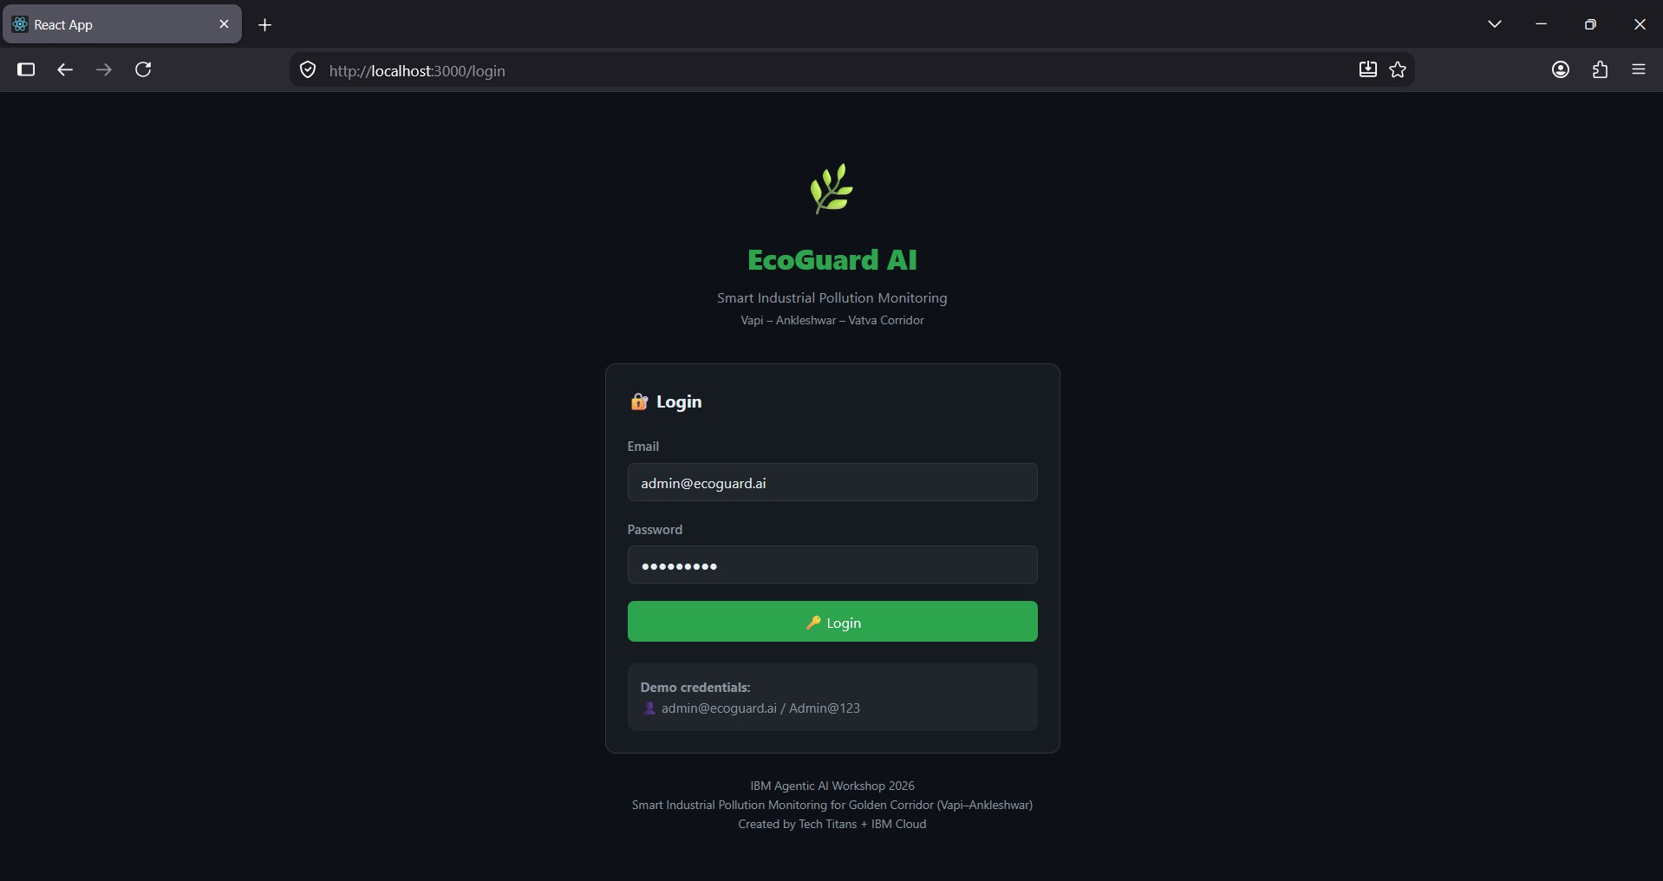

Slide 28
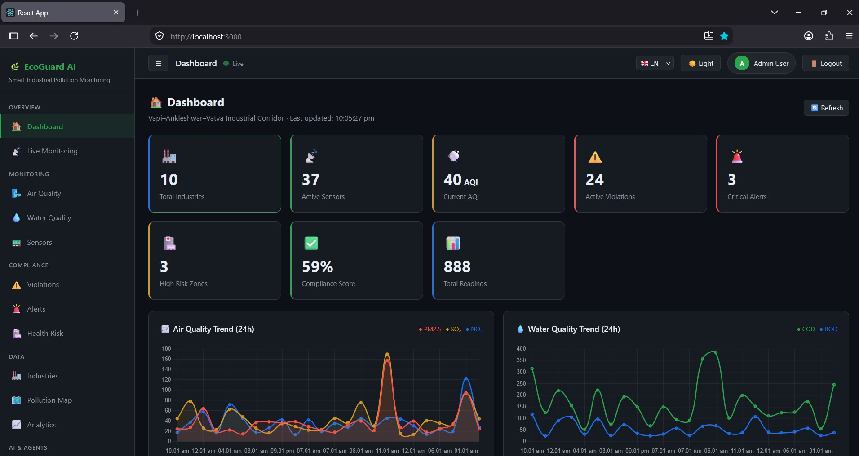

Slide 29
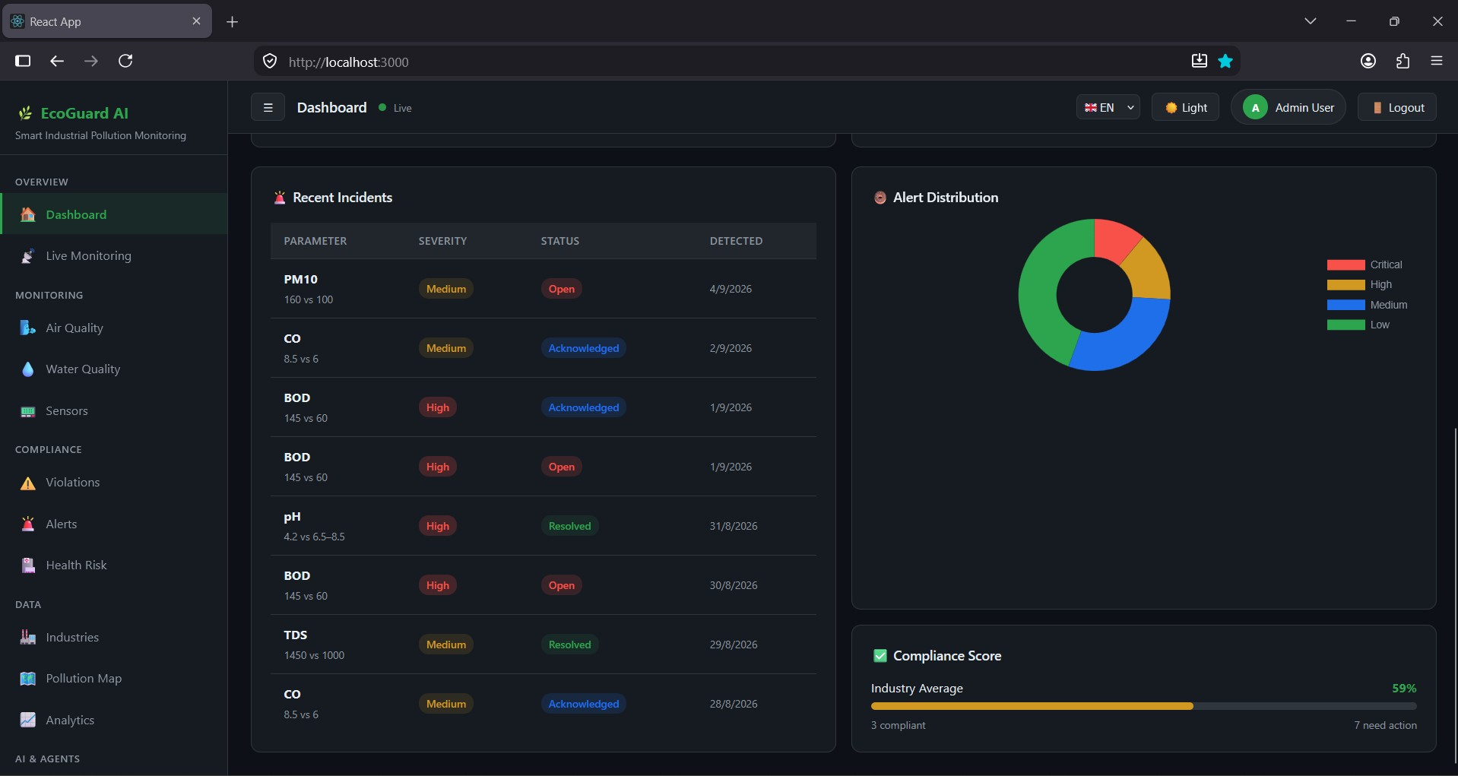

Slide 30
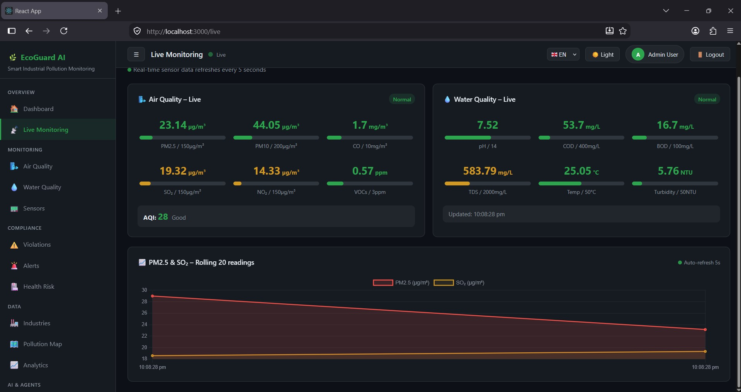

Slide 31
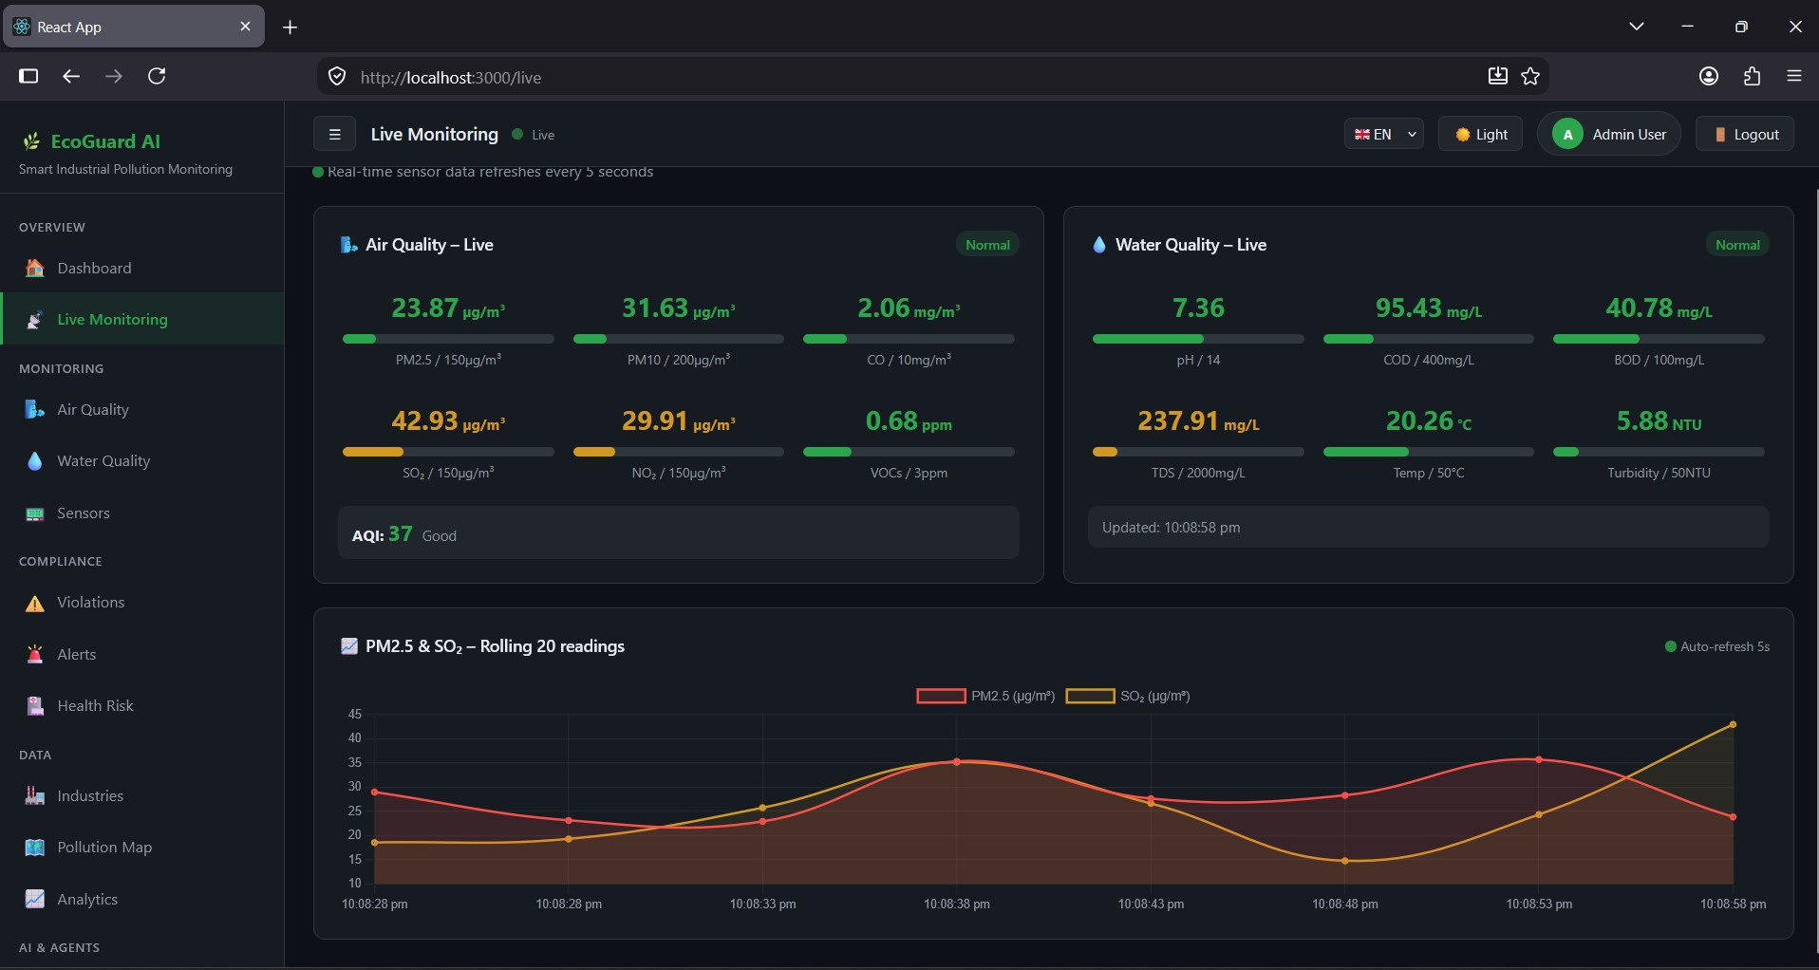

Slide 32
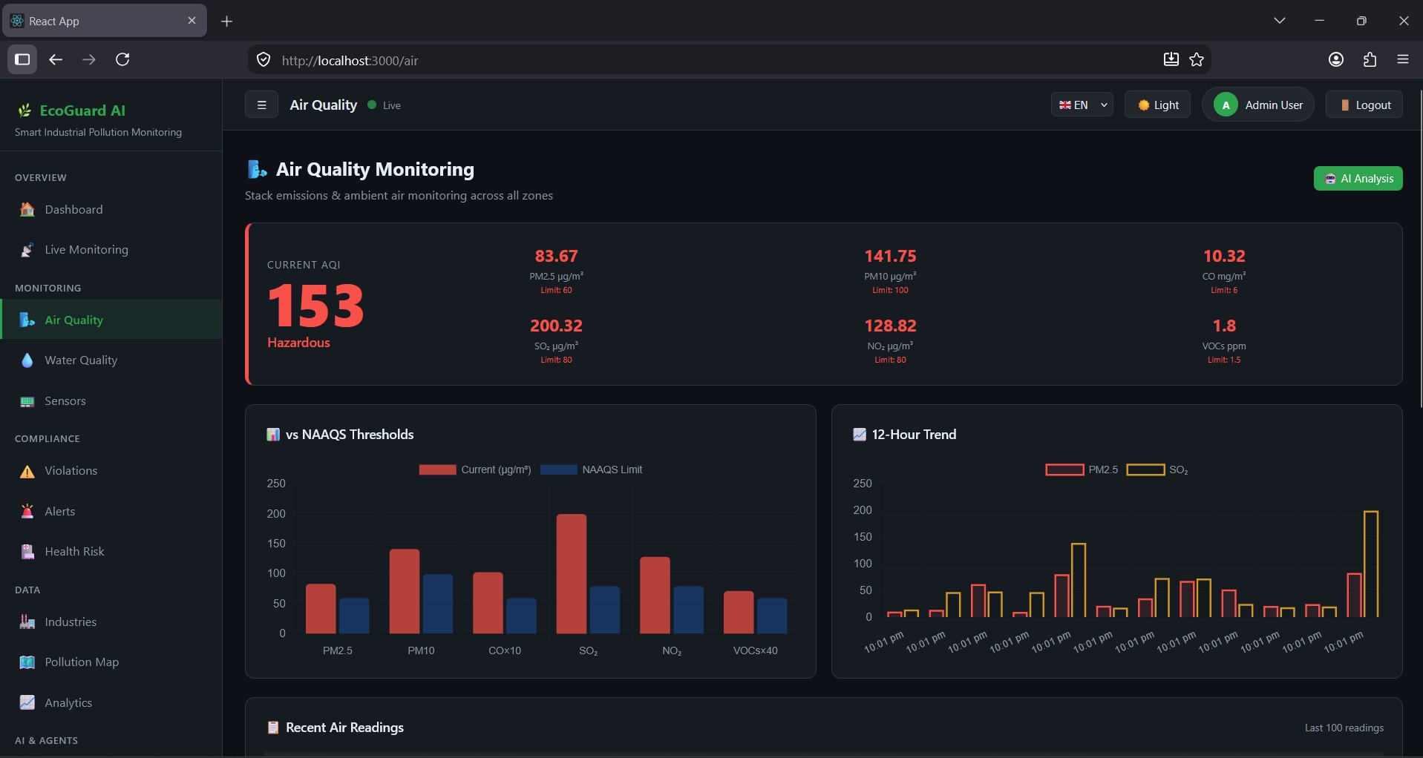

Slide 33
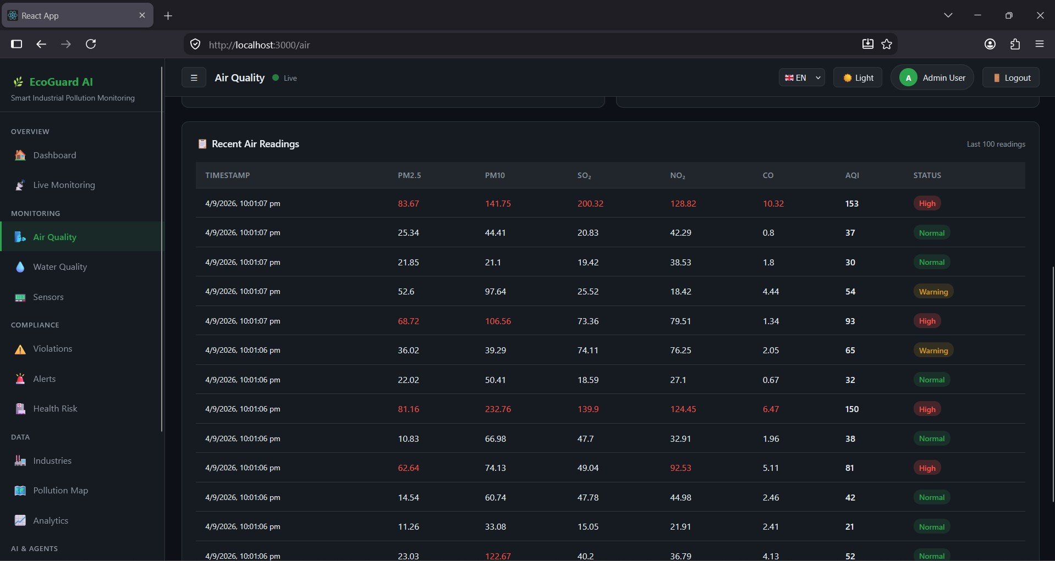

Slide 34
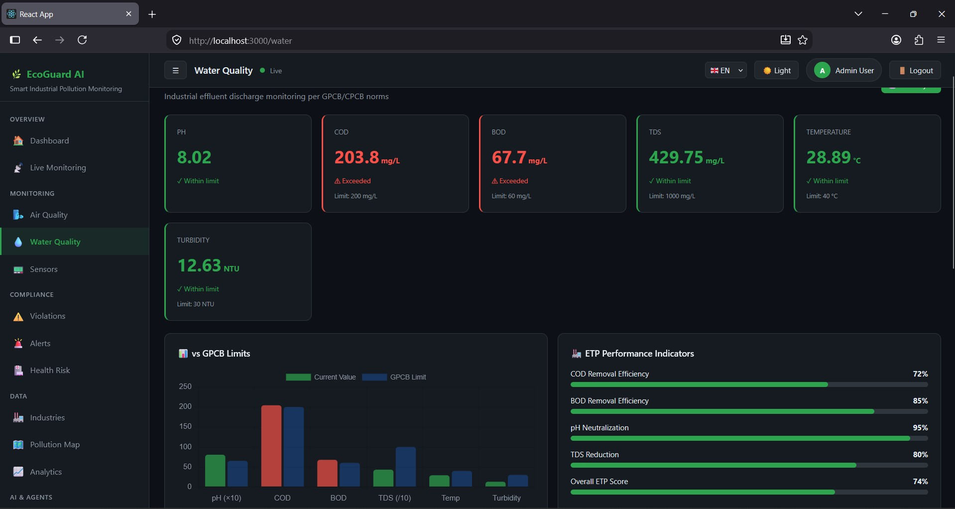

Slide 35
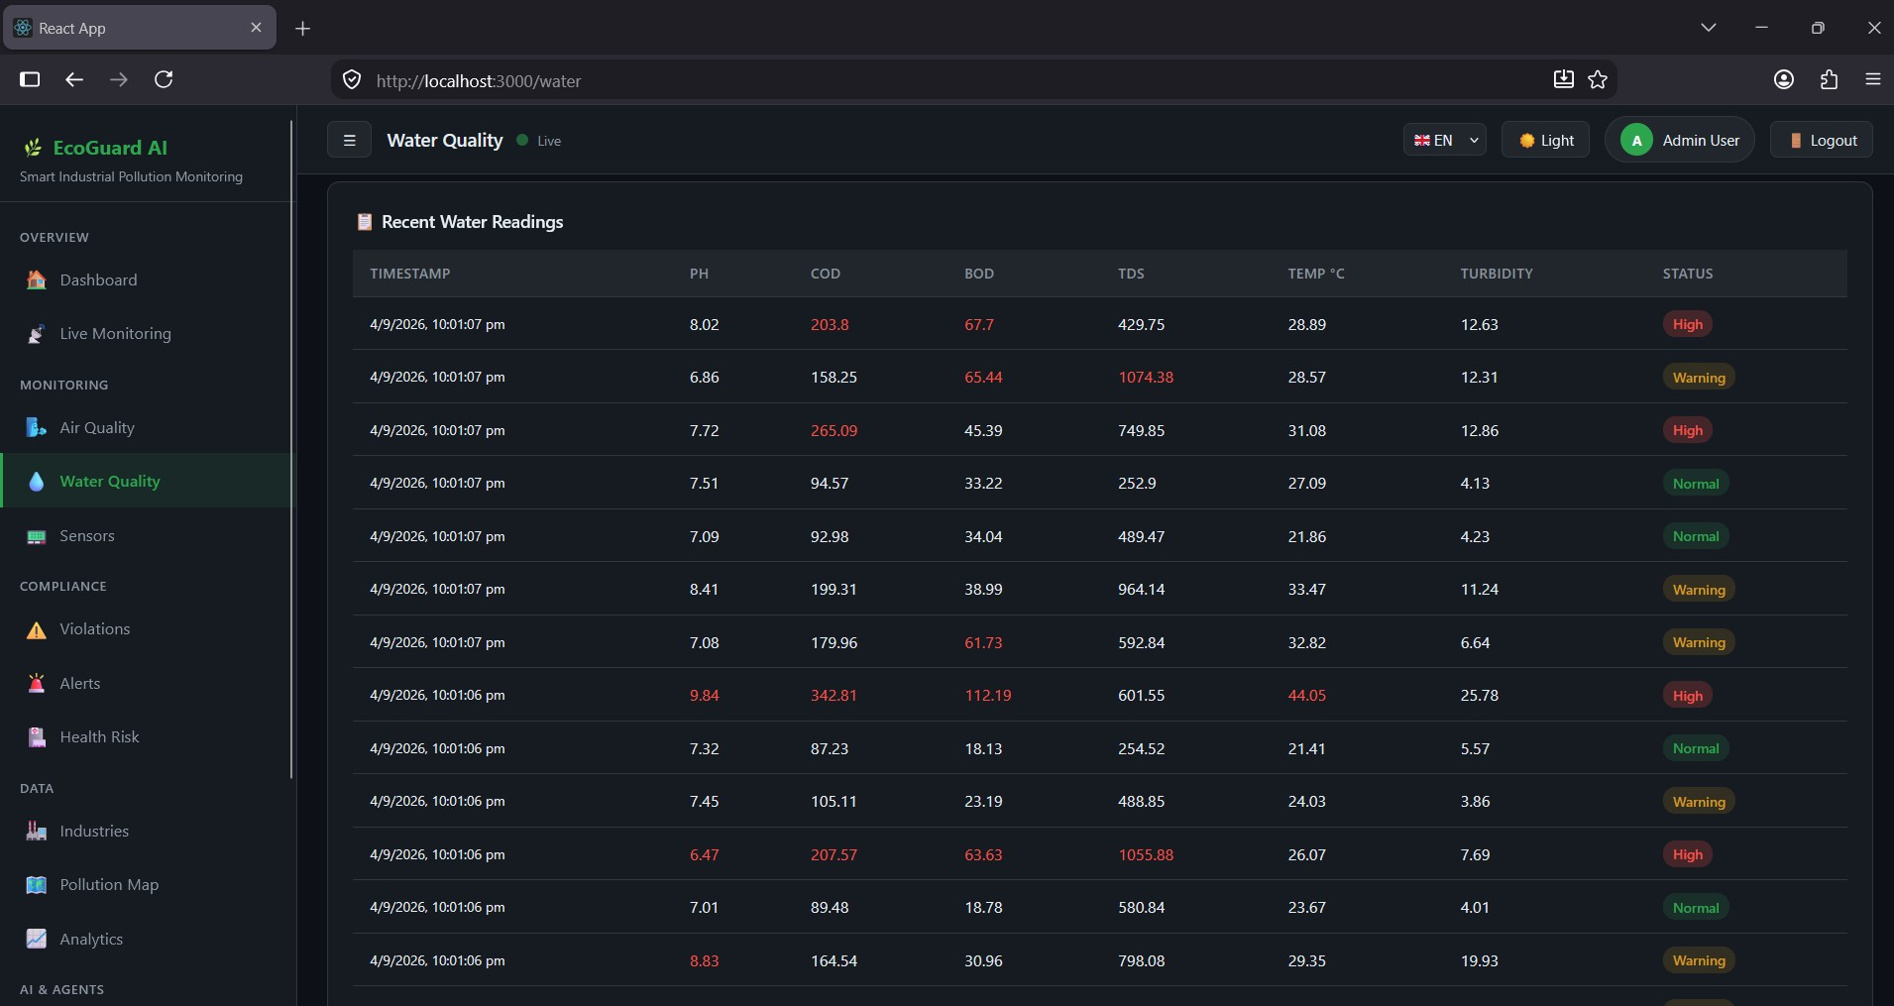

Slide 36
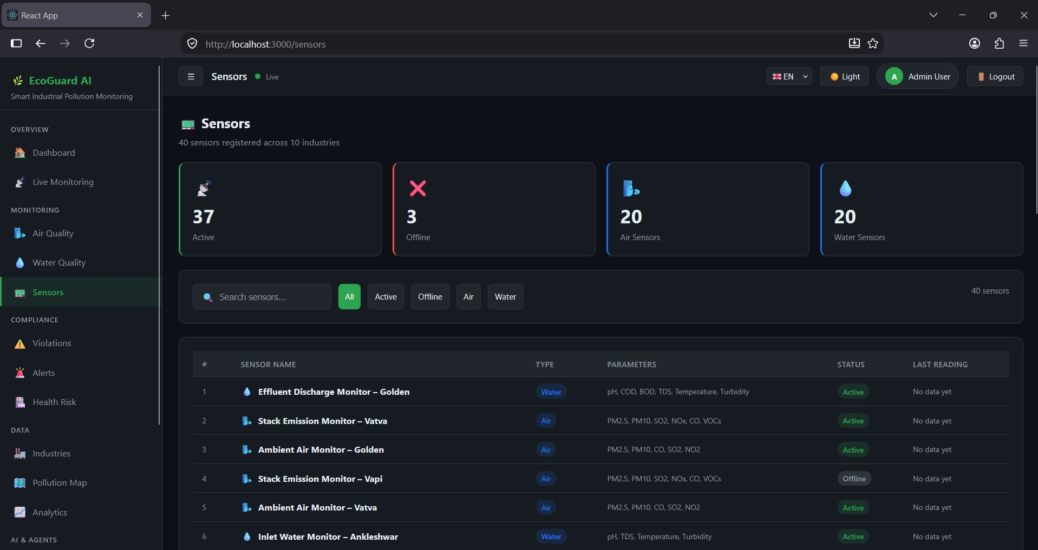

Slide 37
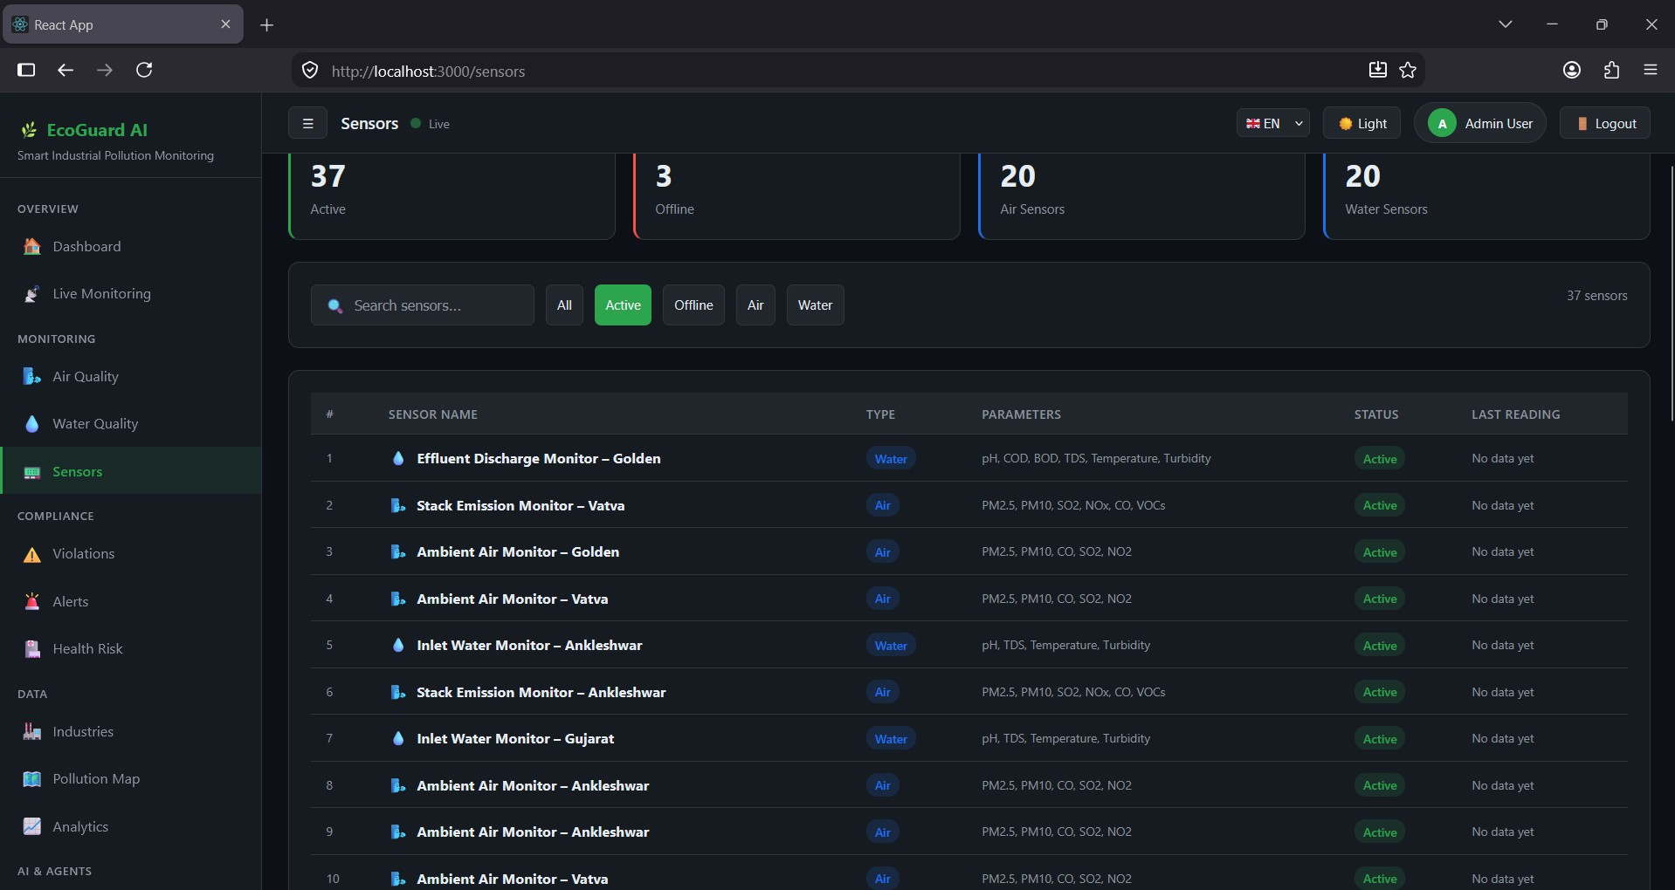

Slide 38
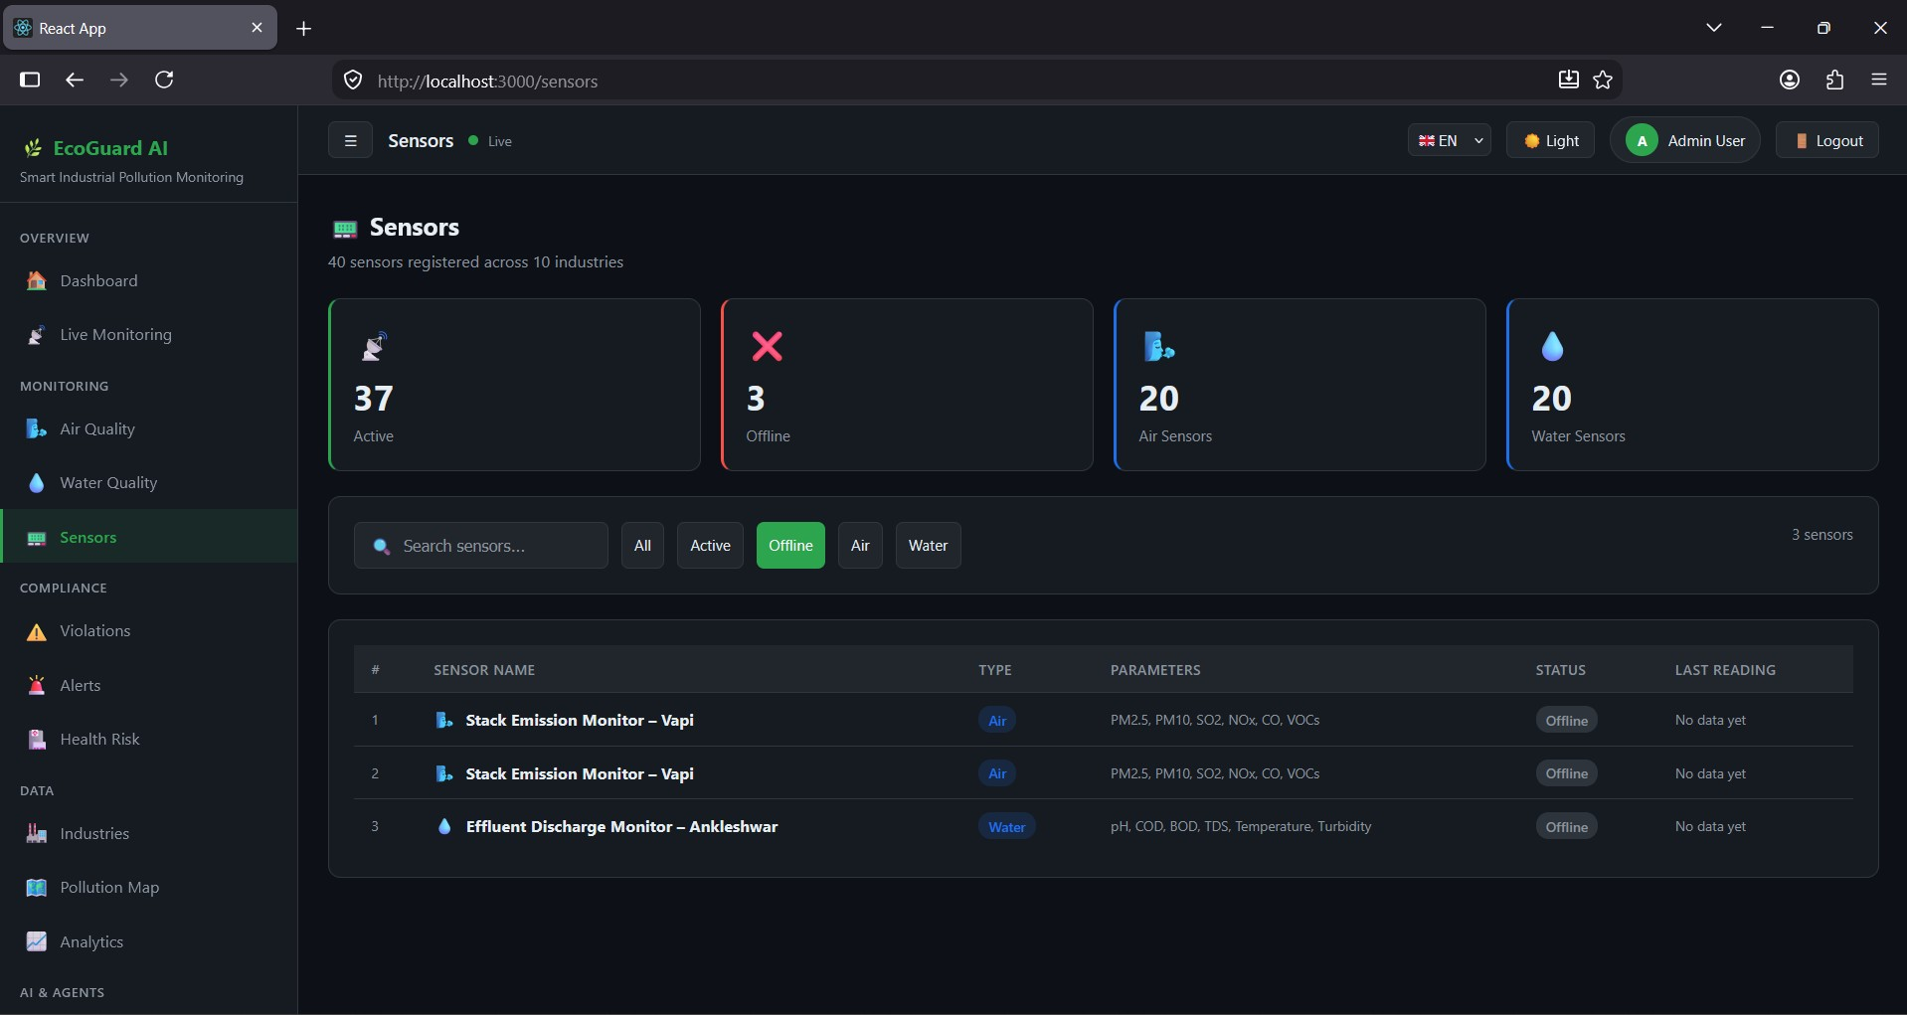

Slide 39
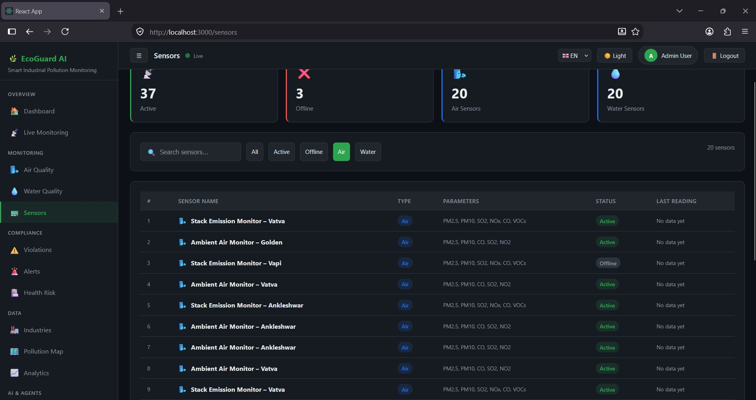

Slide 40
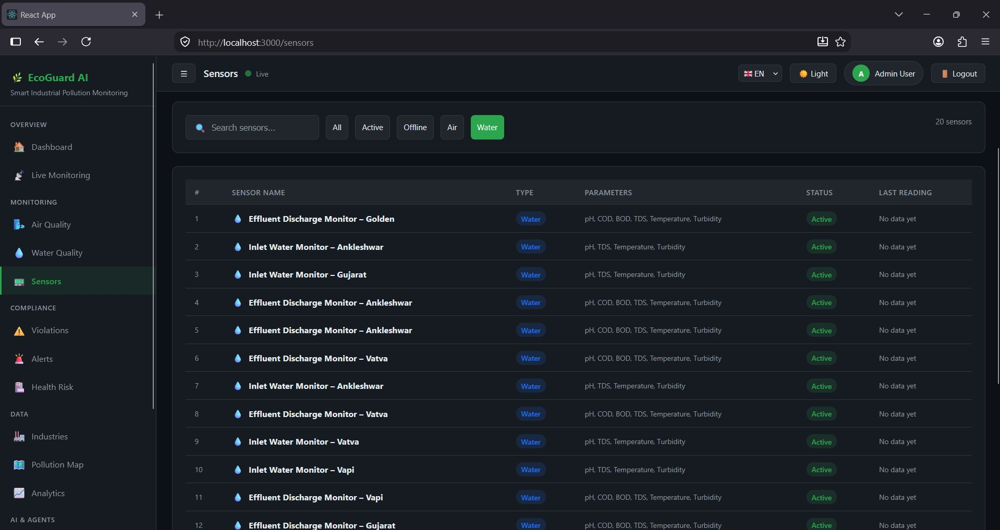

Slide 41
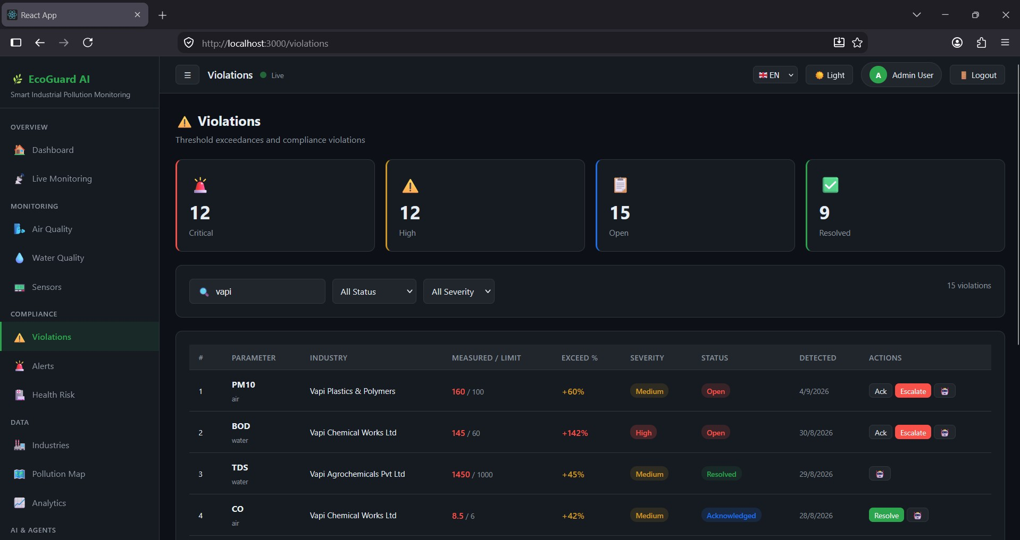

Slide 42
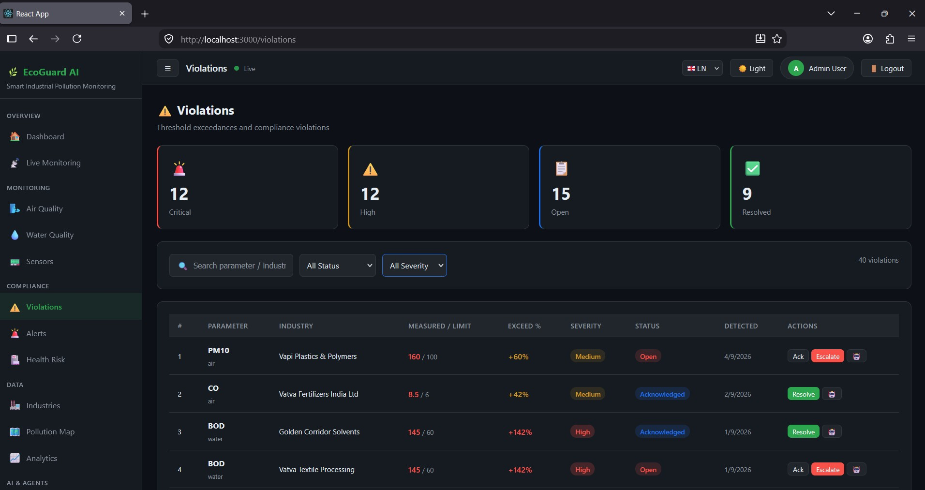

Slide 43
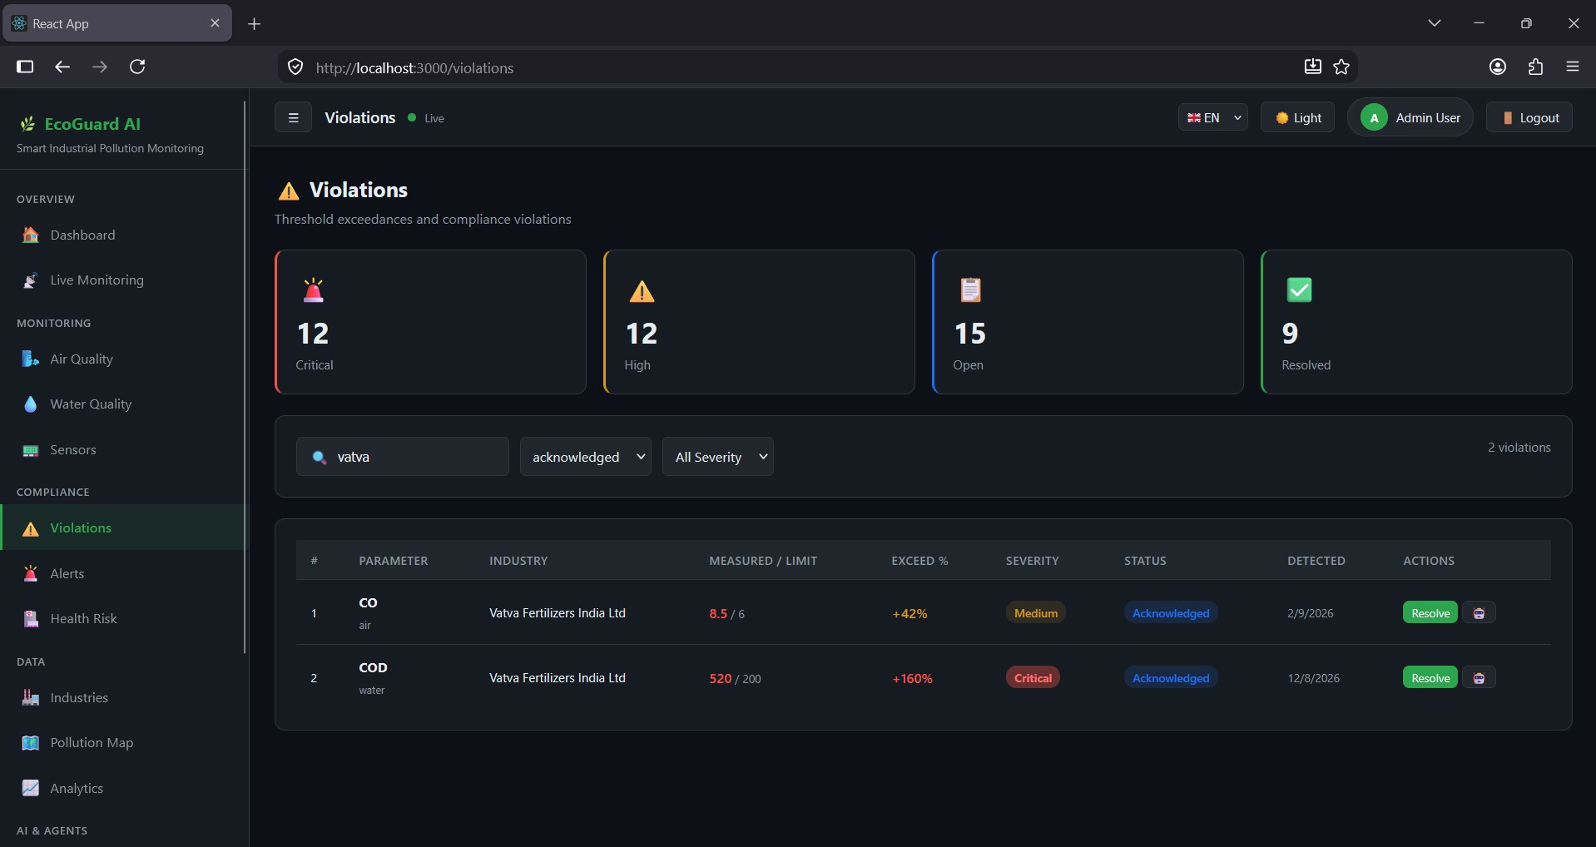

Slide 44
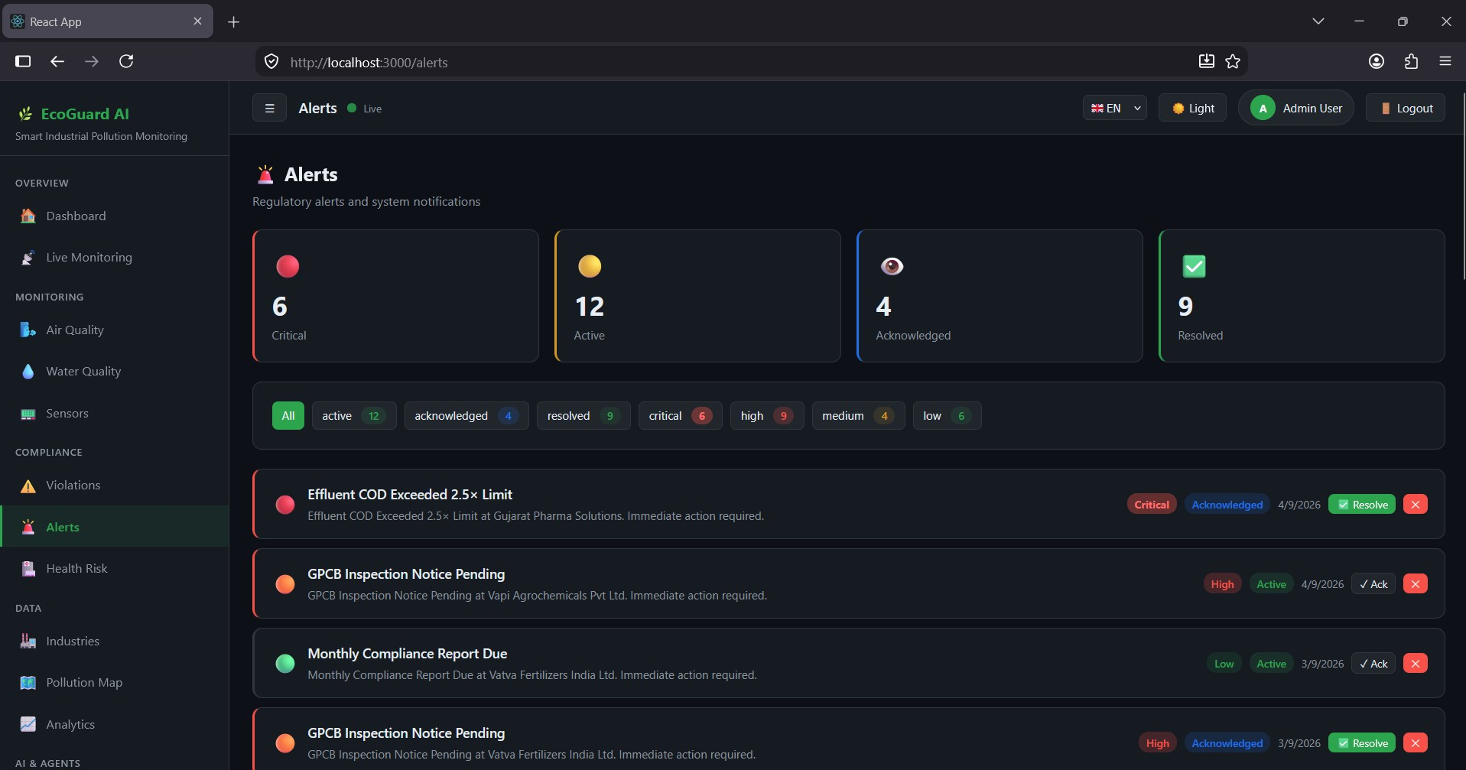

Slide 45
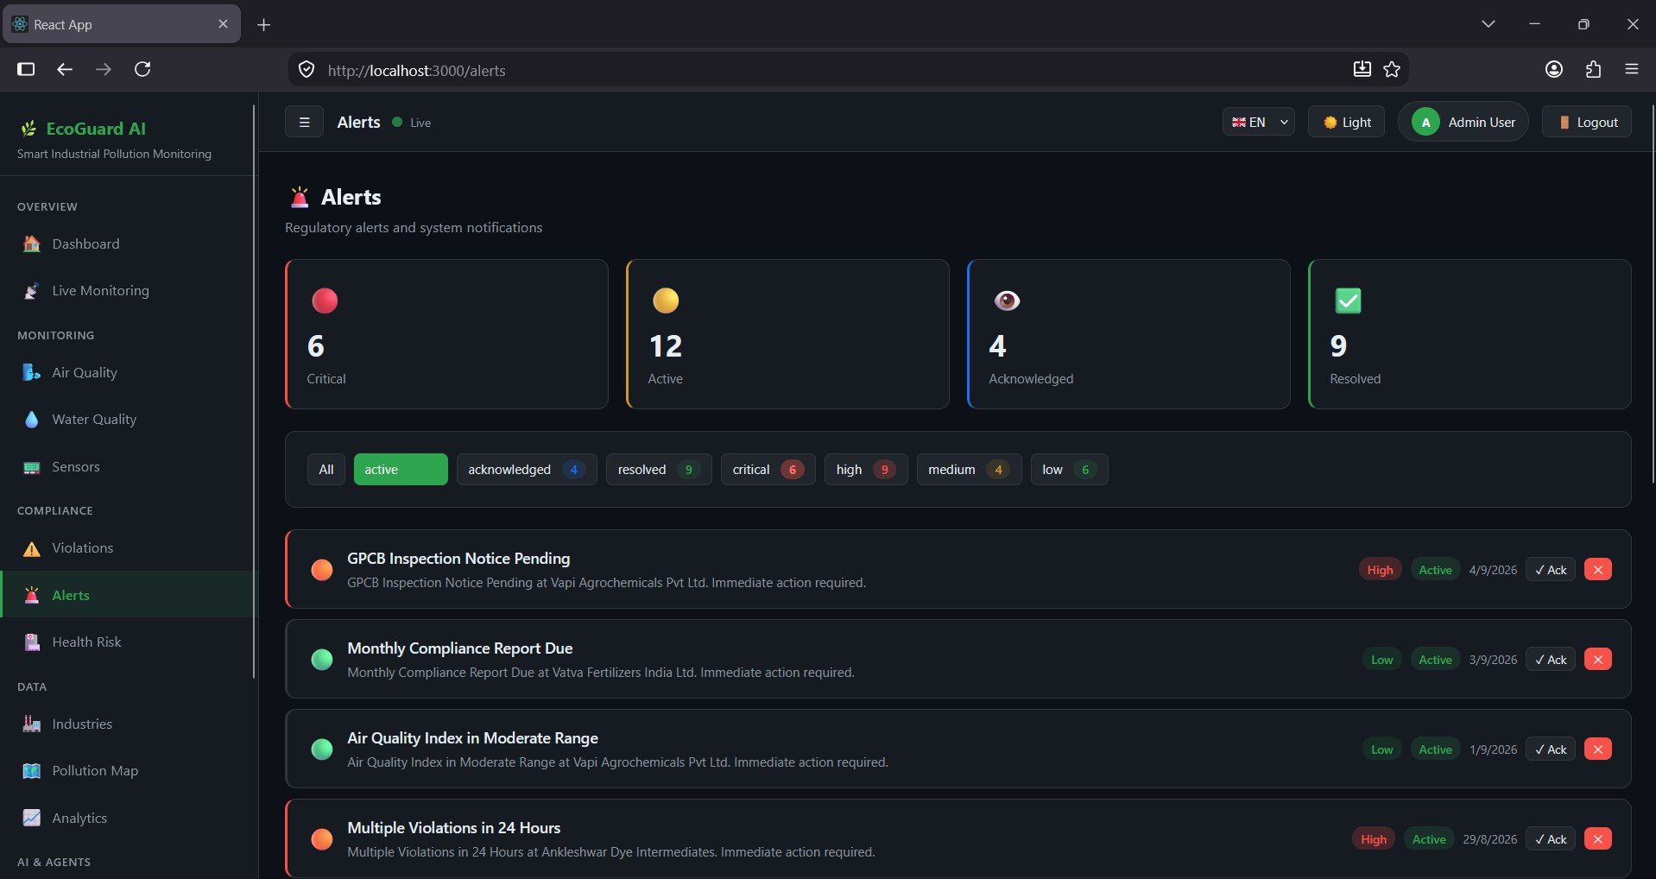

Slide 46
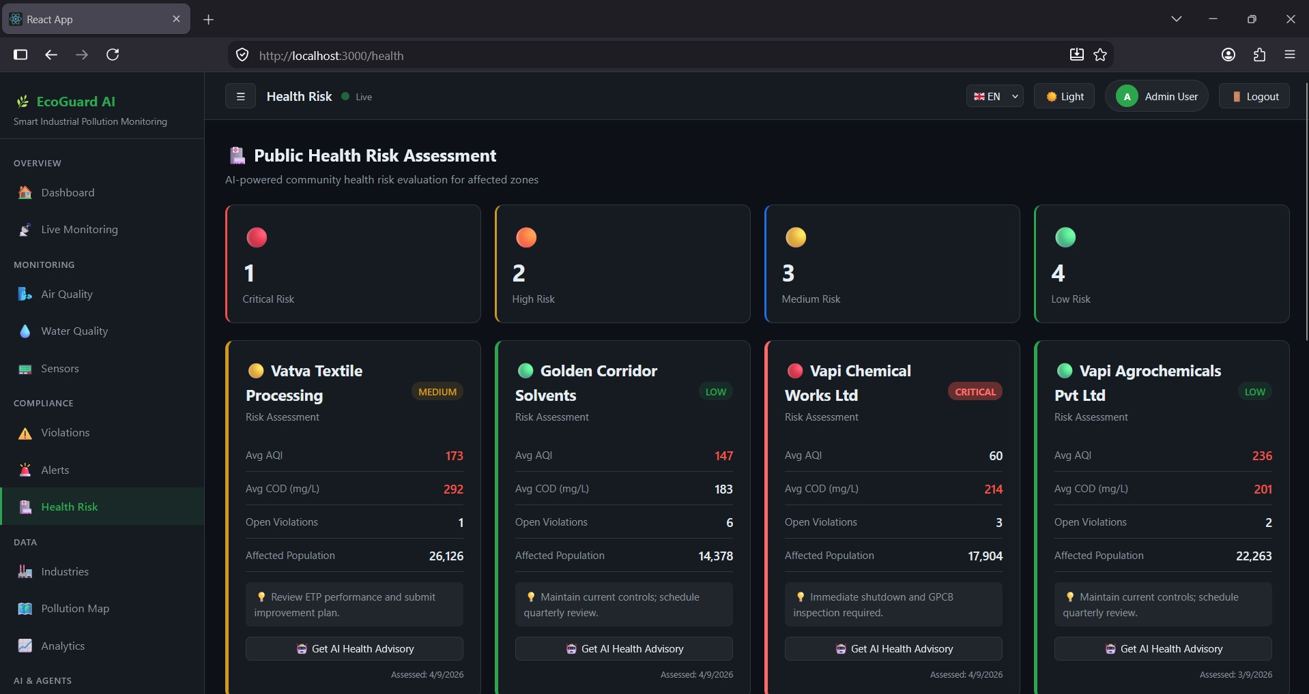

Slide 47
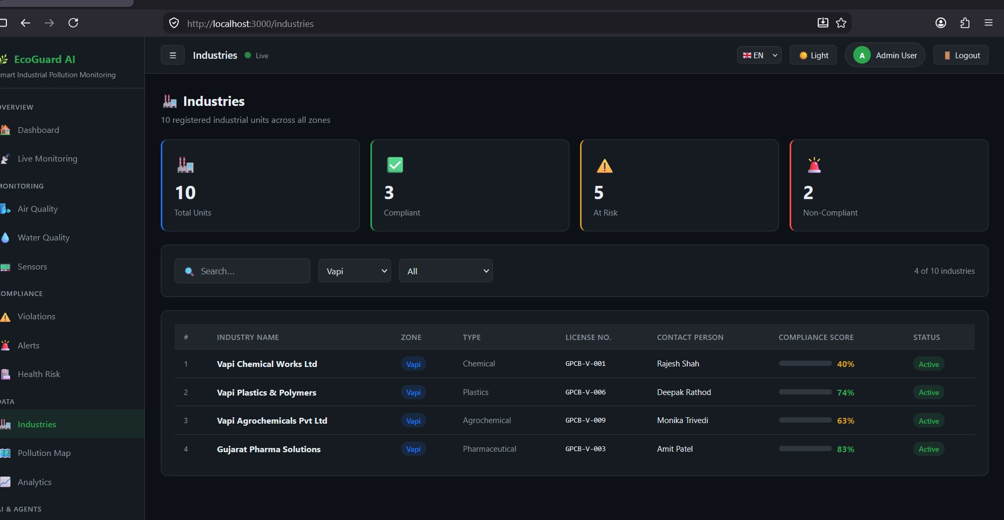

Slide 48
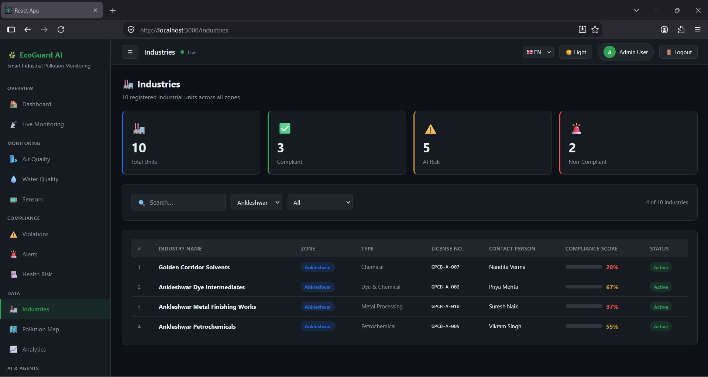

Slide 49
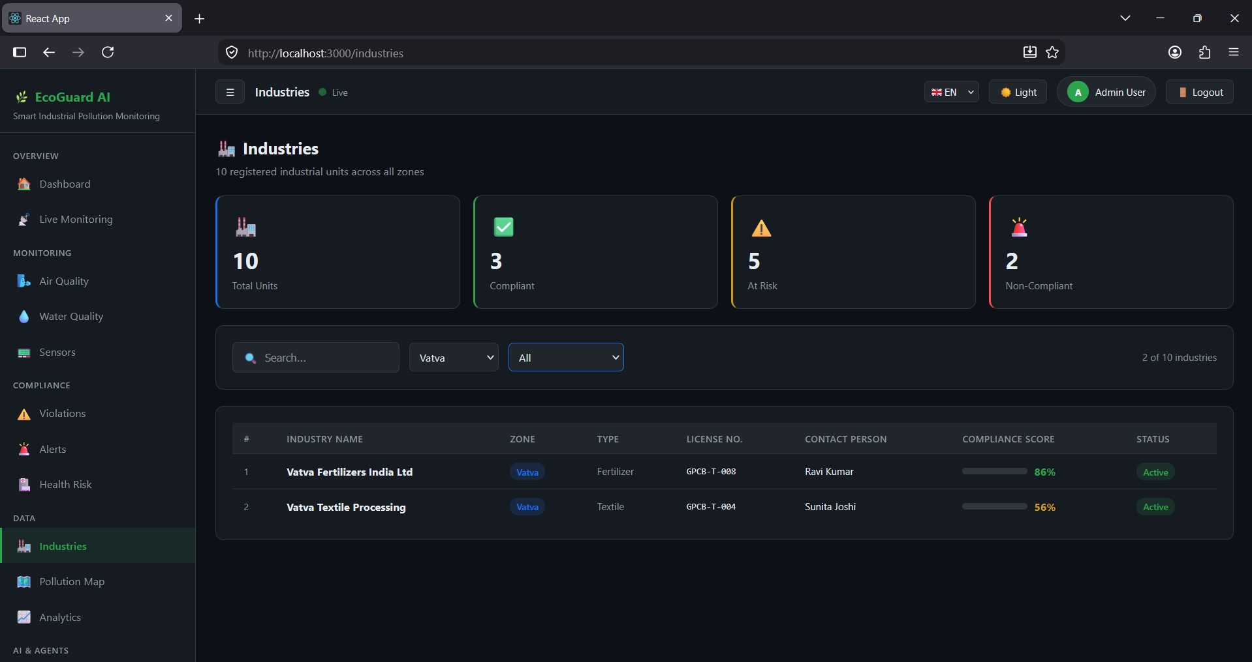

Slide 50
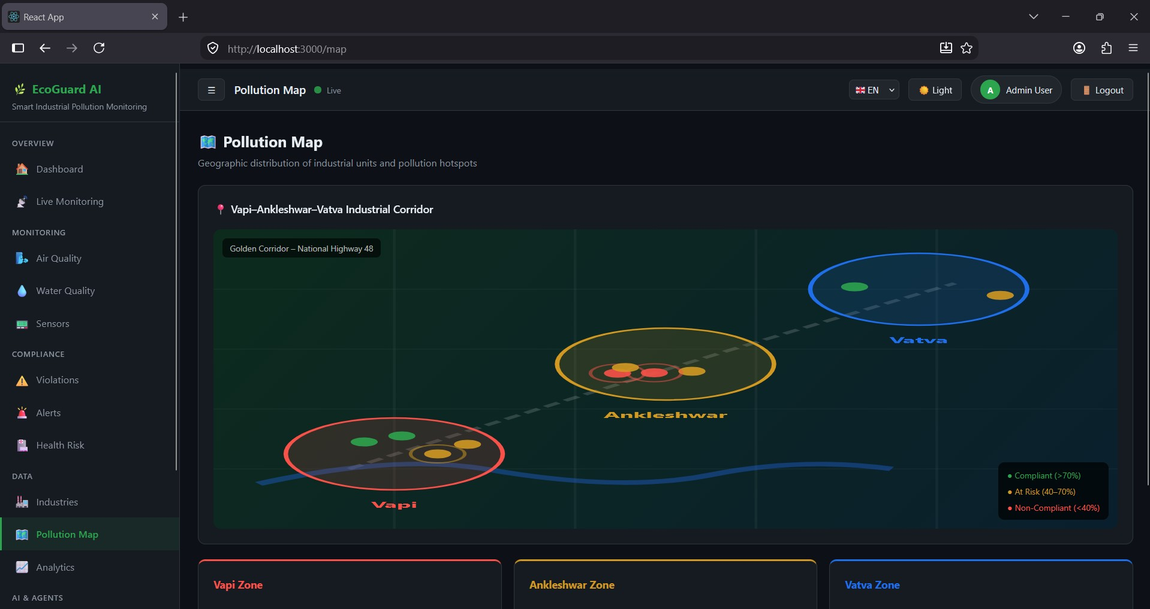

Slide 51
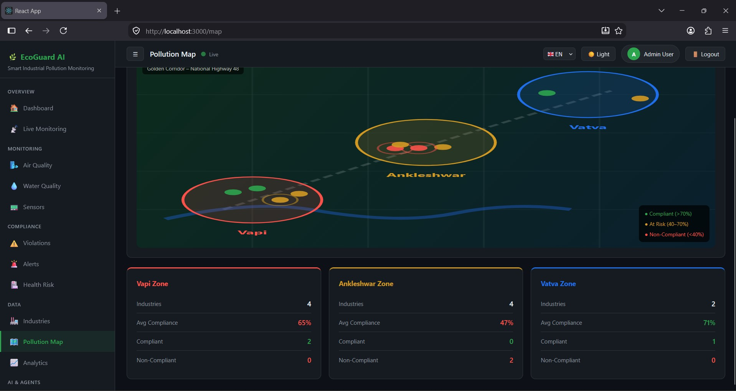

Slide 52
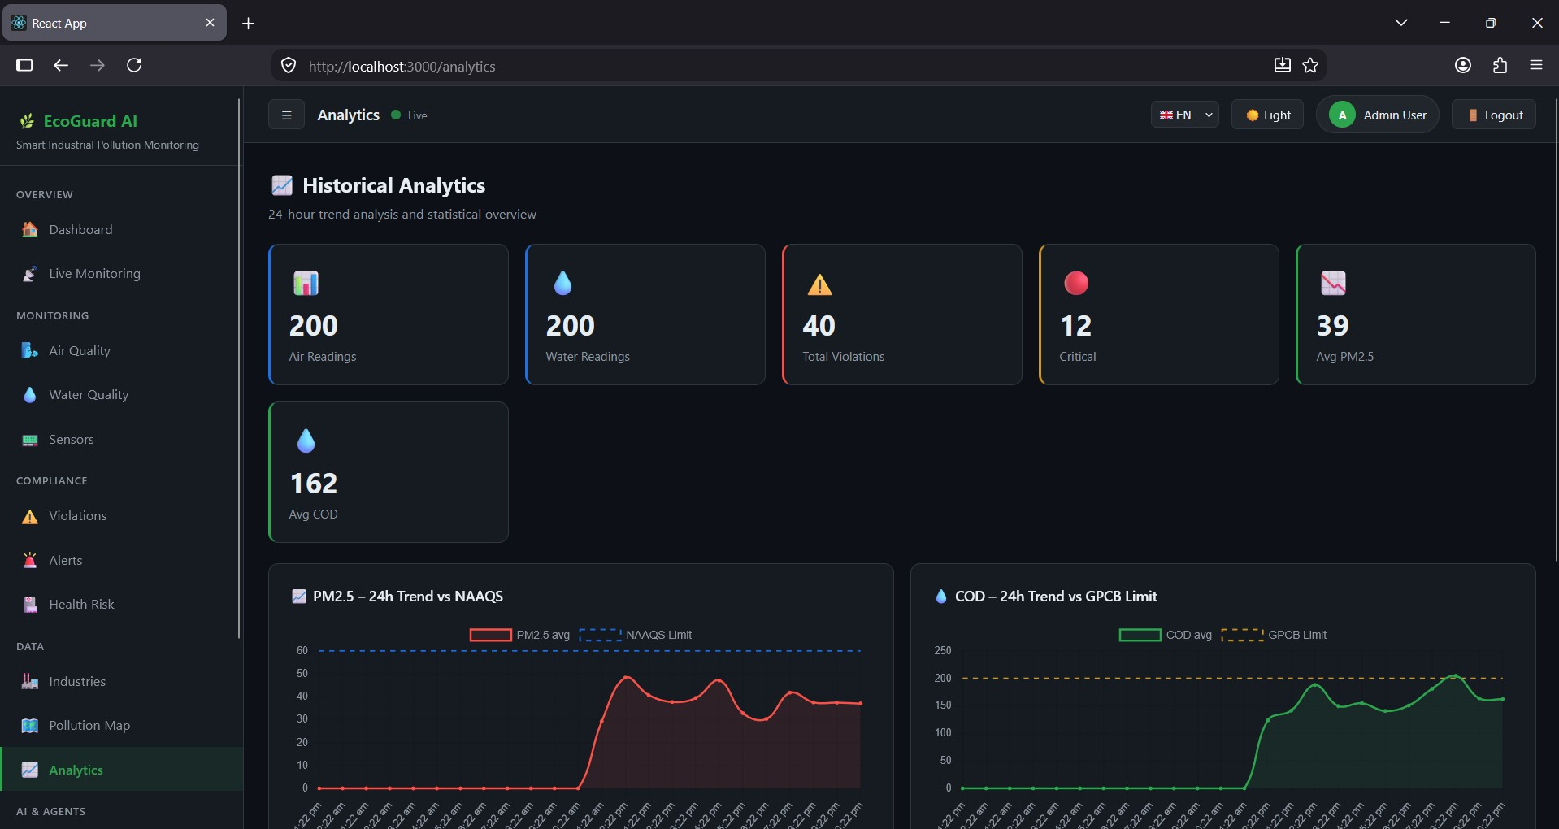

Slide 53
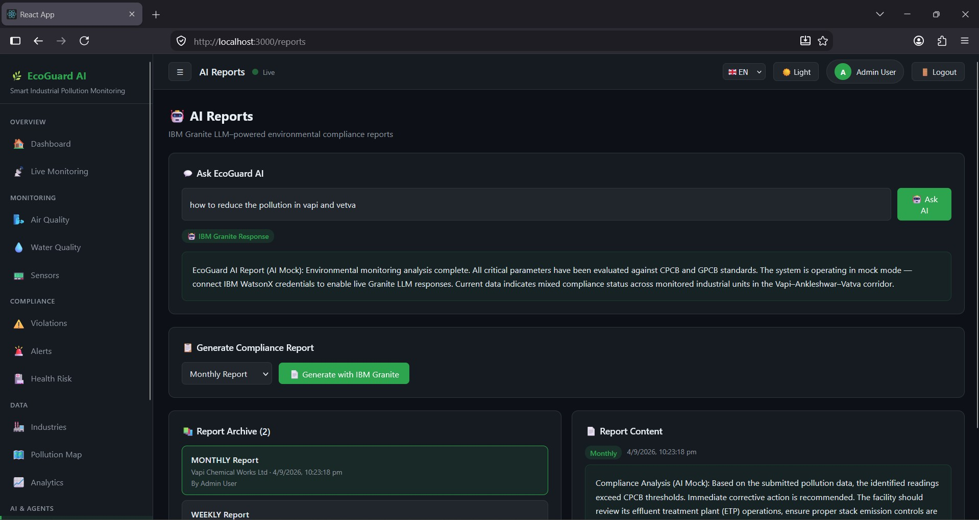

Slide 54
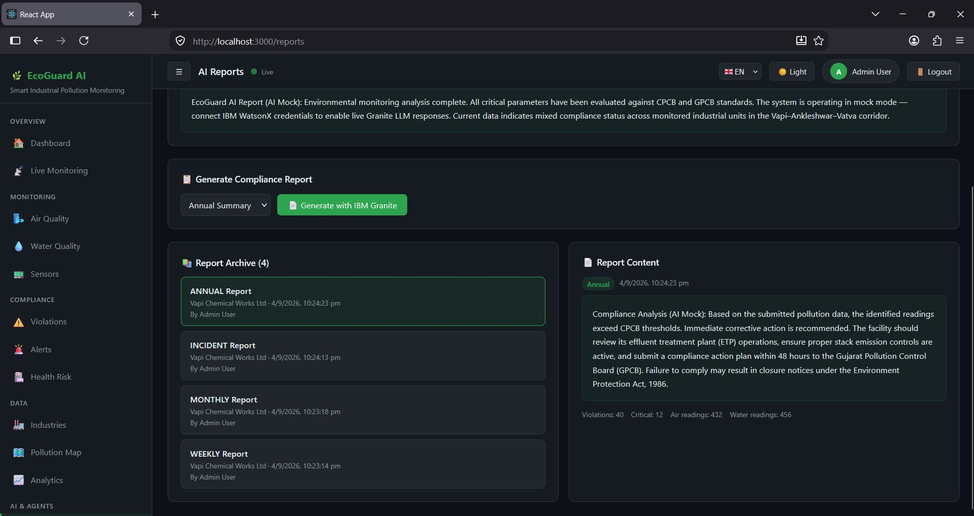

Slide 55
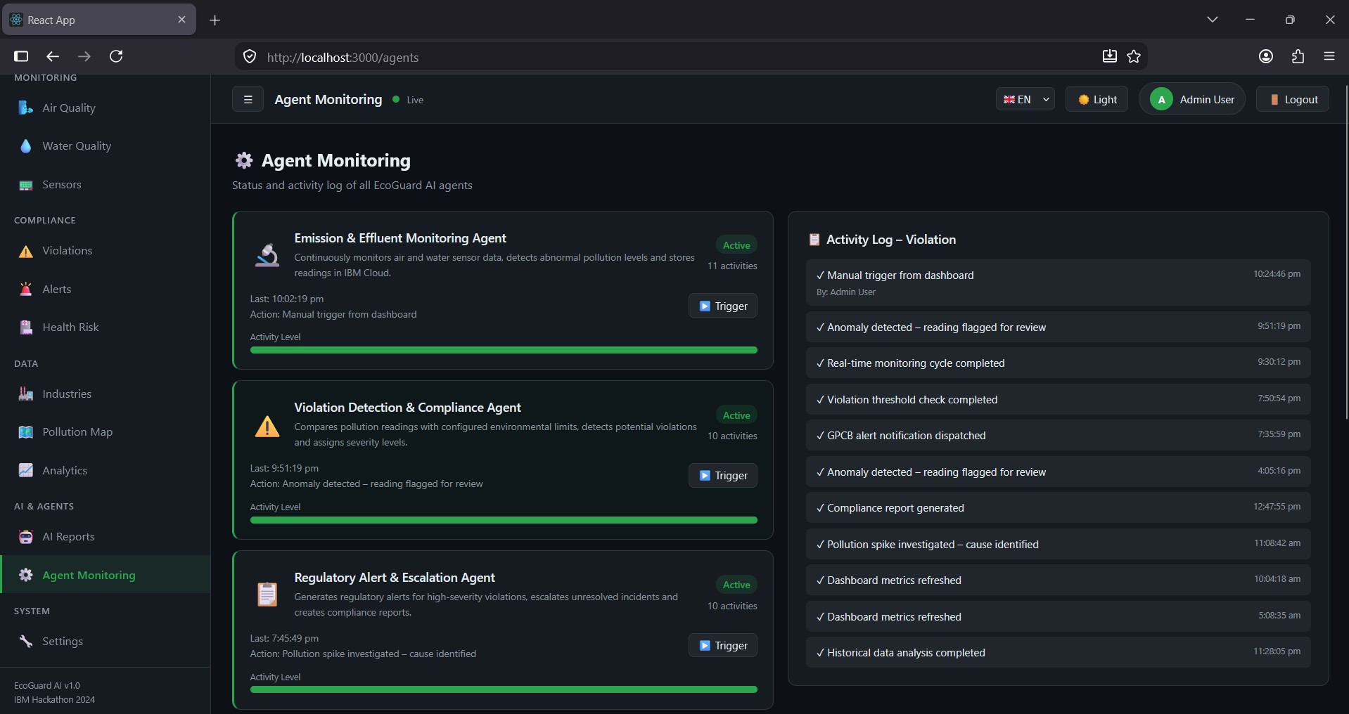

Slide 56
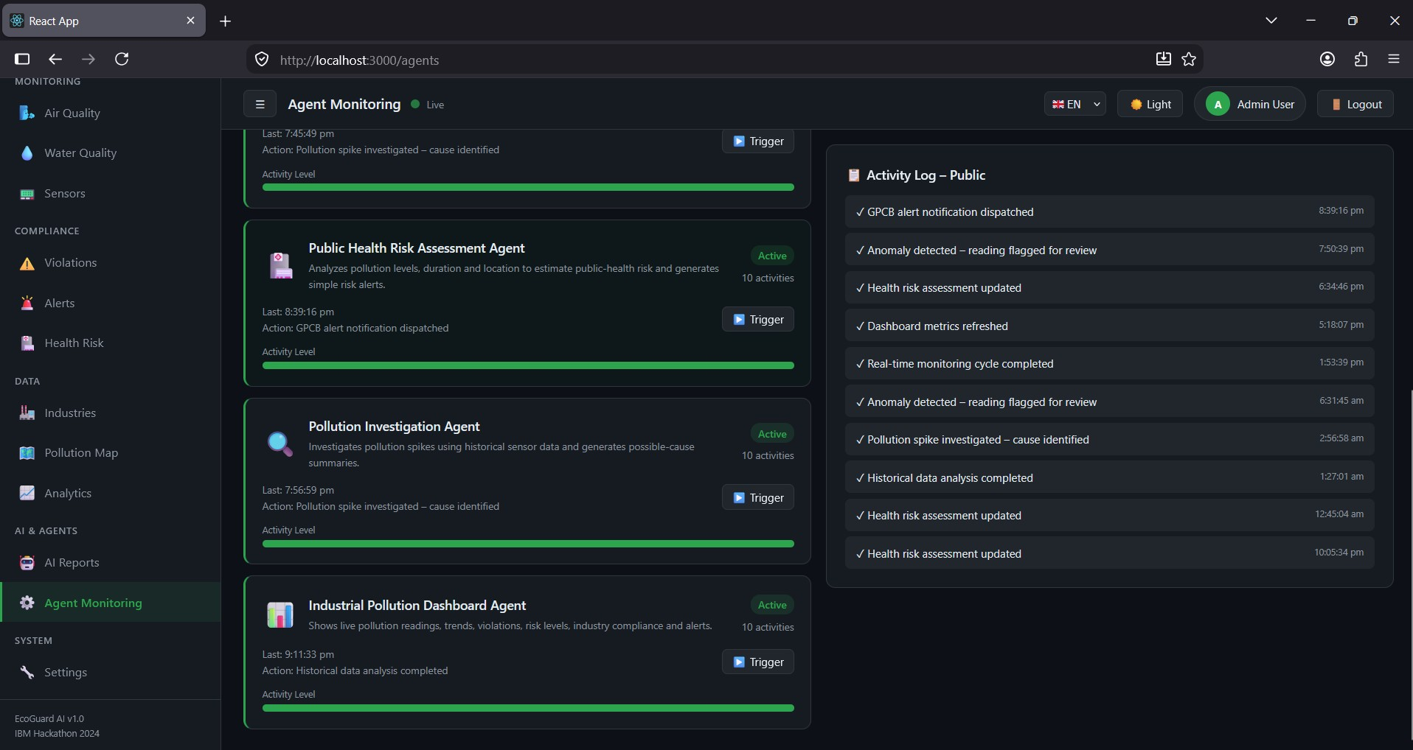

Slide 57
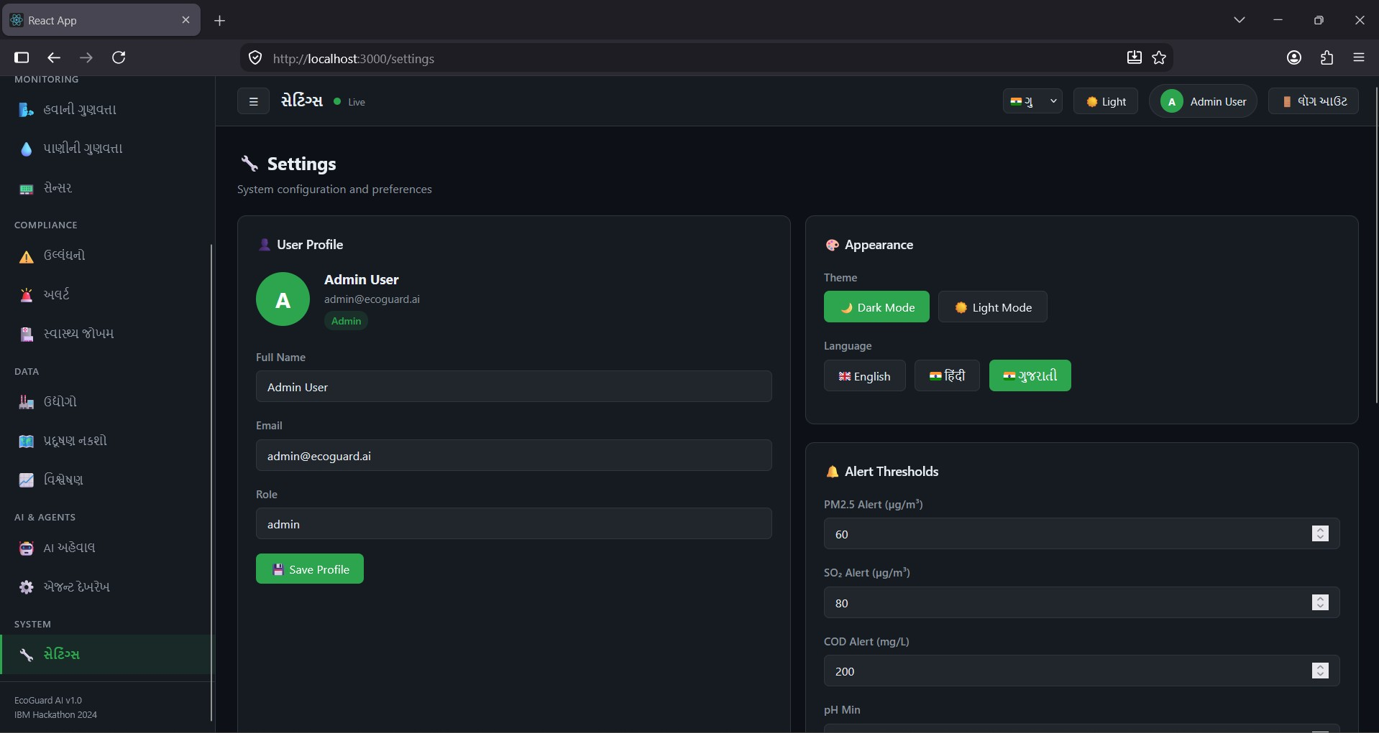

Slide 58
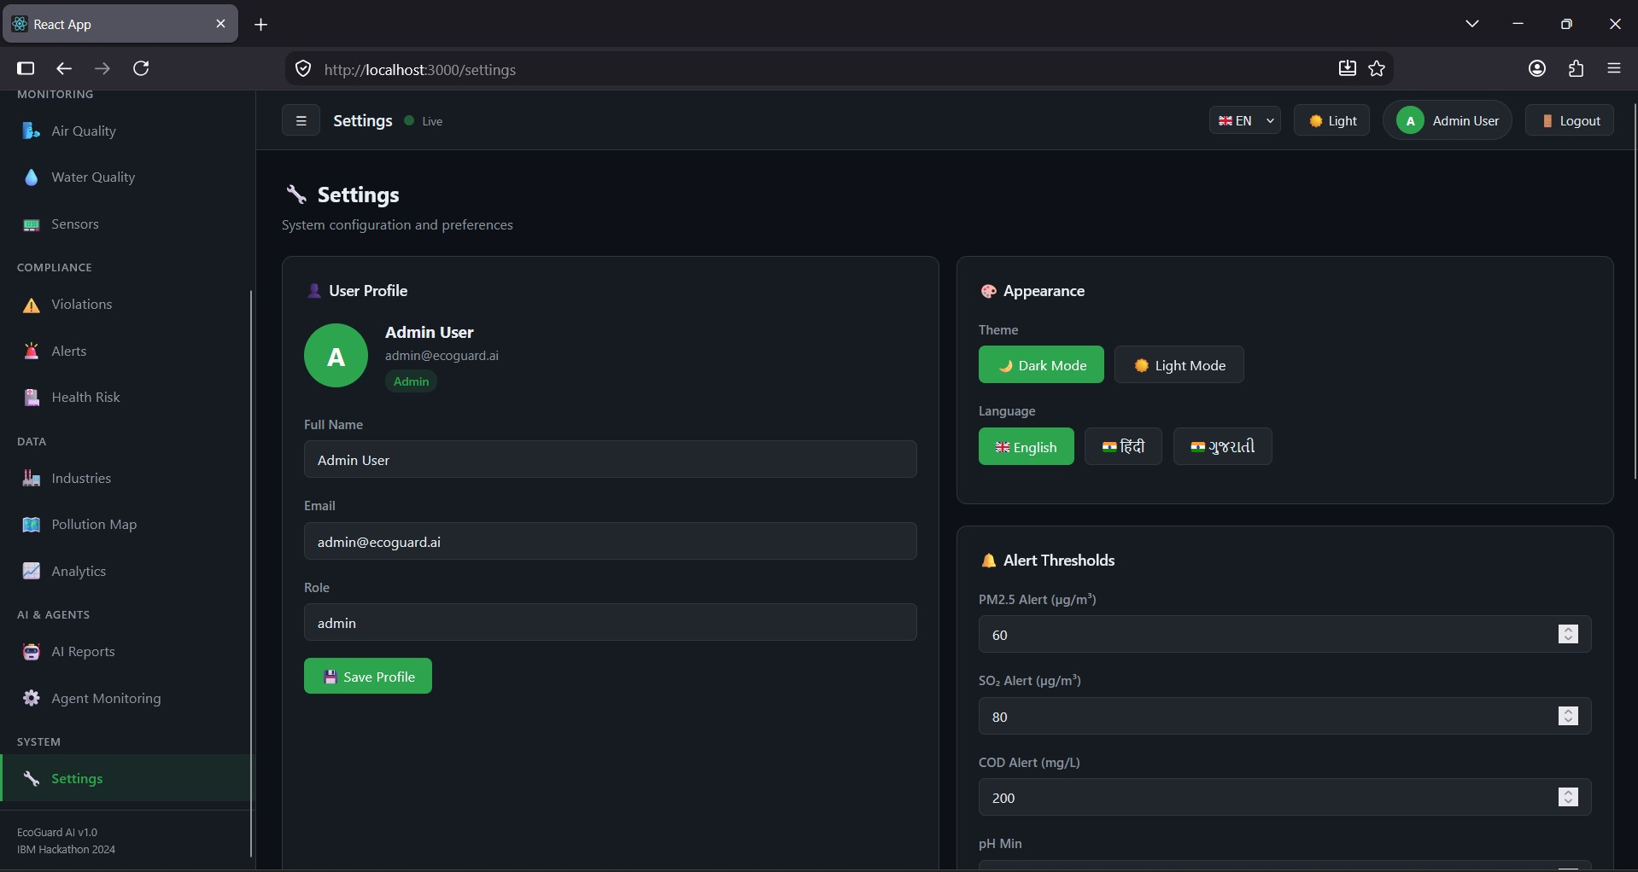

Slide 59
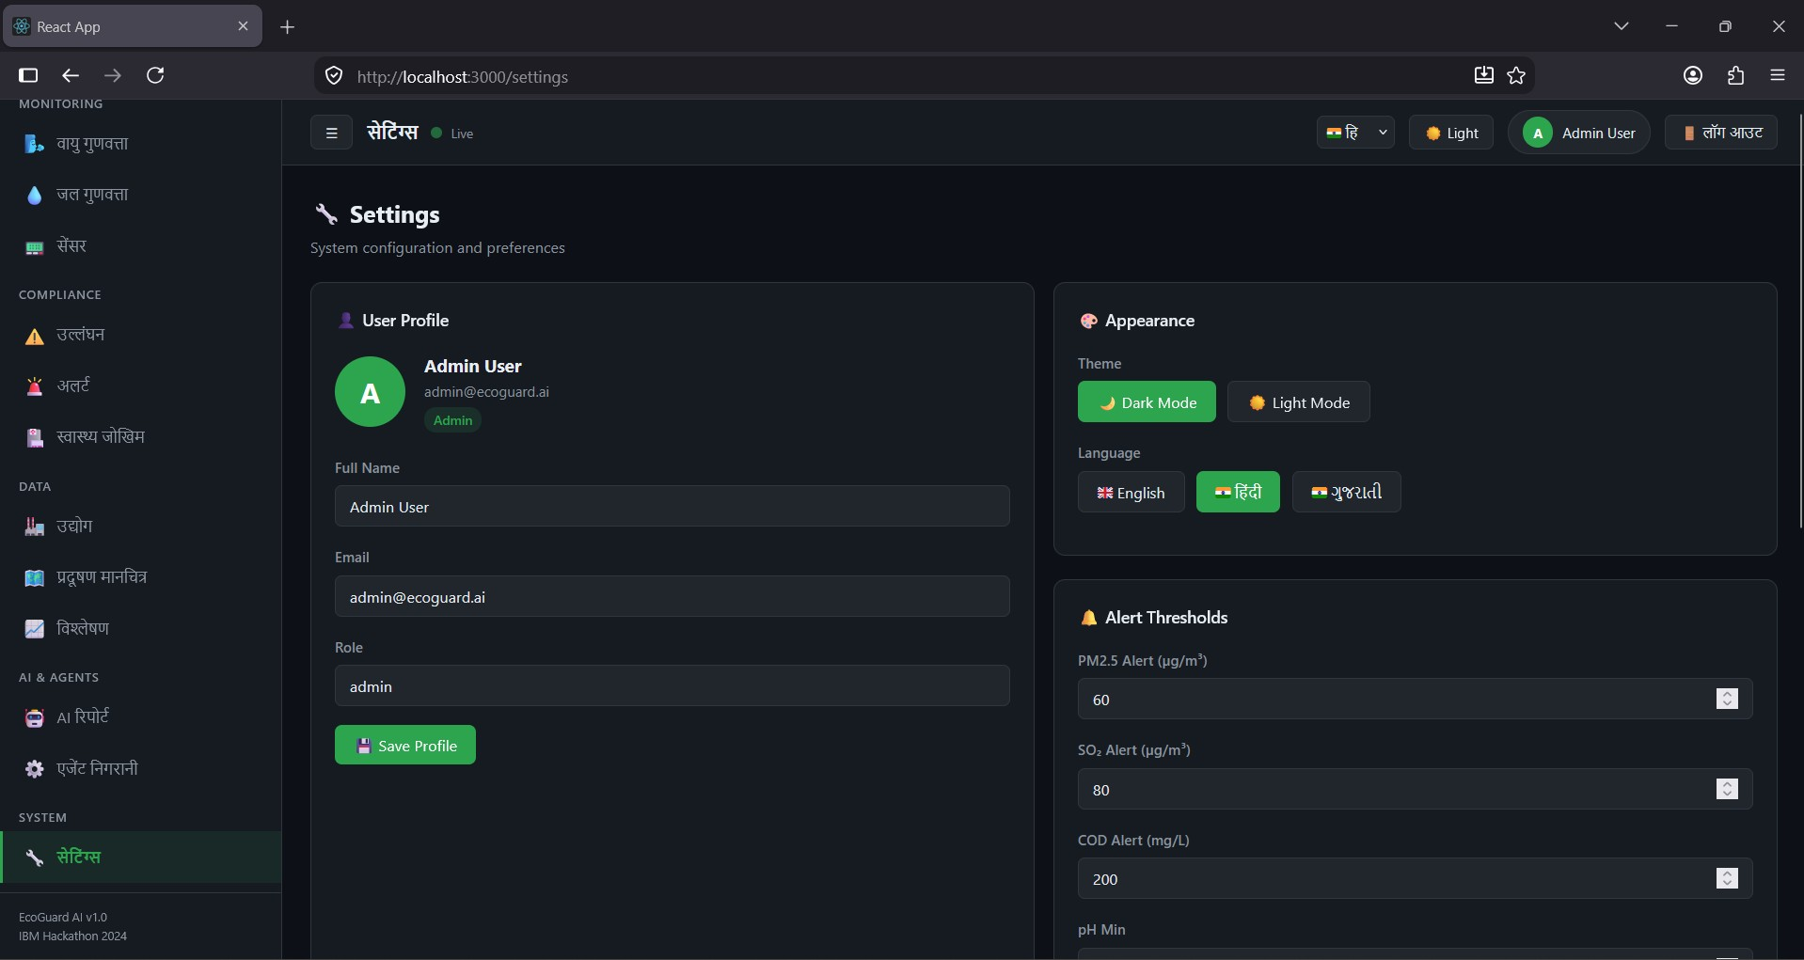

Slide 60
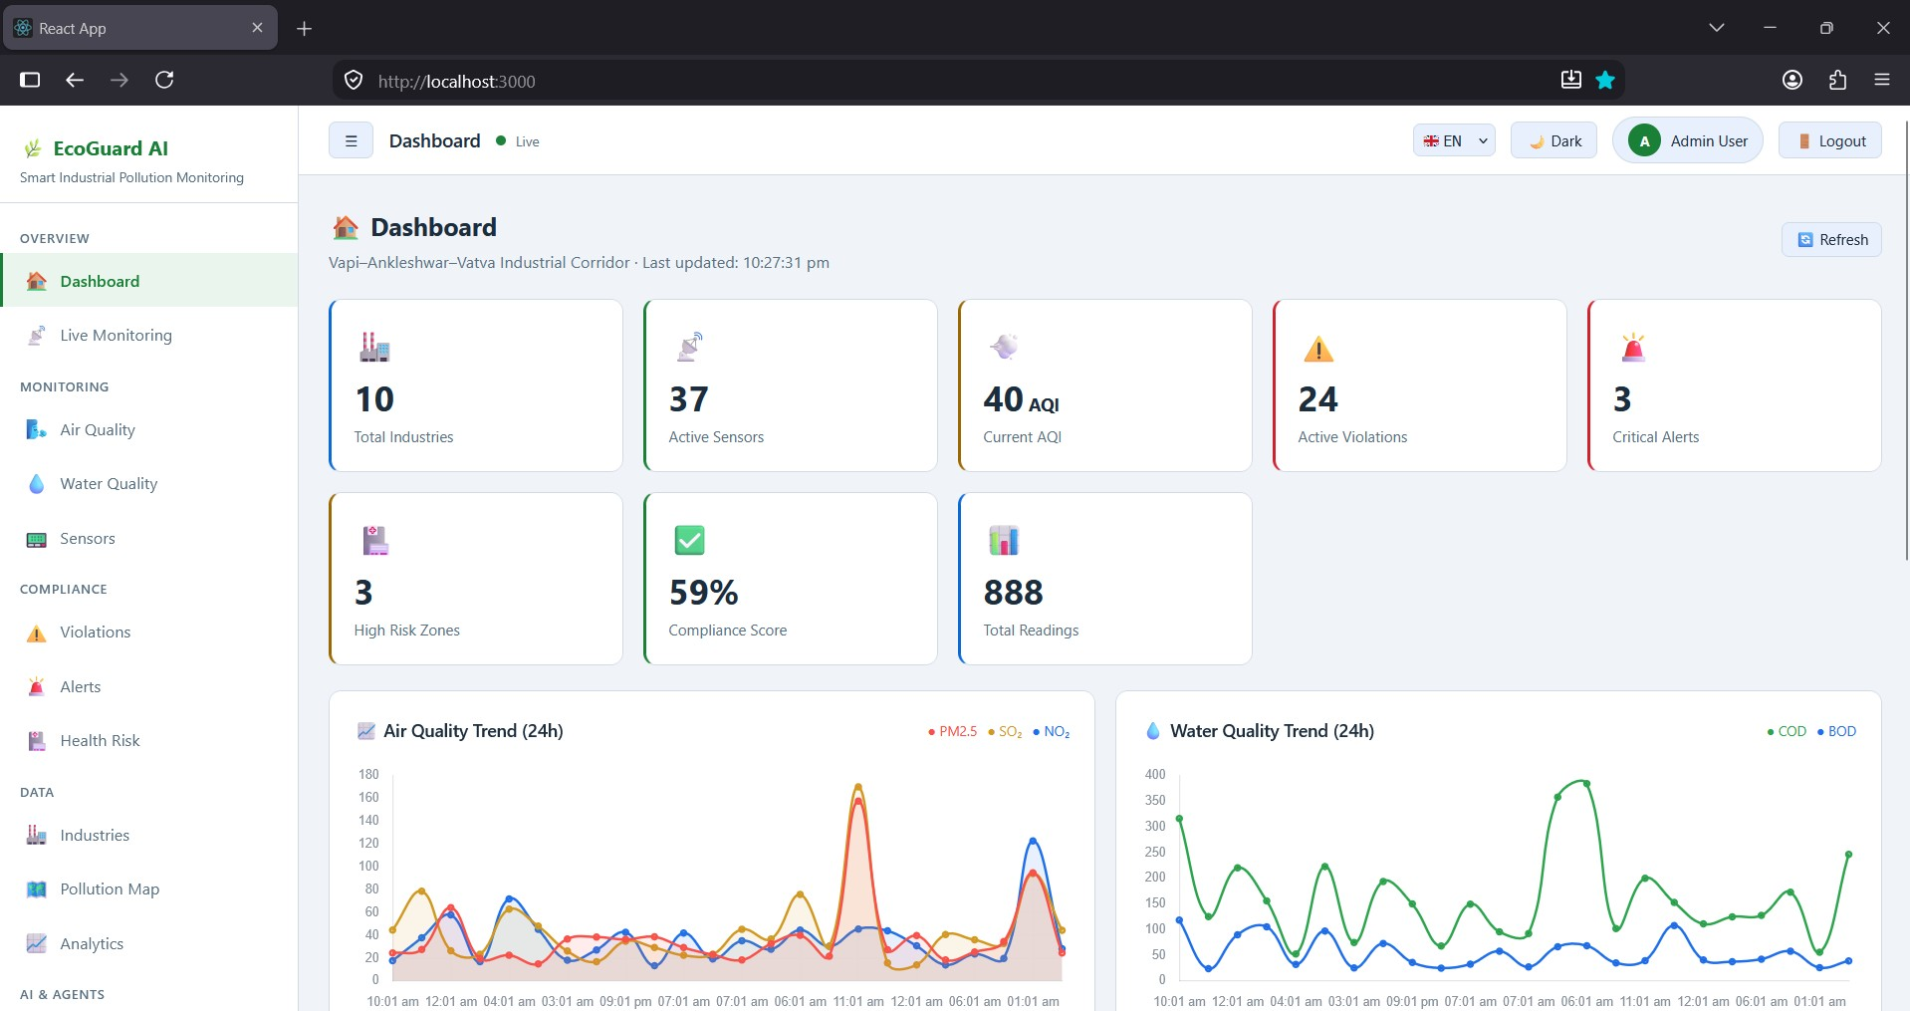

Slide 61

14. Future Scope

Slide 62
Future Scope
Real IoT Sensors – Integrate real-time air, water, and industrial emission sensors to continuously collect accurate environmental data and reduce dependency on simulated readings.
Satellite Integration – Use satellite imagery to identify pollution patterns, industrial expansion, vegetation stress, and environmental changes over large areas.
Pollution Prediction – Apply machine learning to historical and real-time data to forecast future pollution levels and provide early warnings before conditions become critical.
Digital Twin – Create a virtual model of the industrial corridor to simulate pollution scenarios and understand the possible impact of different industrial activities.
Automated Regulation – Generate pollution evidence, compliance reports, and AI-based recommendations to help regulatory authorities review violations and take faster action.
Mobile App – Develop Android/iOS applications that allow inspectors, officers, and authorized users to monitor pollution data, alerts, violations, and reports from anywhere.
Citizen Alerts – Provide timely notifications through SMS, email, and mobile apps when critical pollution events may affect nearby communities.
Advanced AI/ML – Introduce advanced models for anomaly detection, pollution forecasting, source identification, pattern recognition, and environmental risk prediction.
Computer Vision – Use cameras with AI to identify visible smoke, industrial leakage, unauthorized discharge, and unusual emission activities.
GIS Mapping – Develop interactive GIS maps showing industry locations, sensor positions, pollution intensity, environmental risk zones, and affected areas across Vapi–Ankleshwar–Vatva.

Slide 63
15. Conclusion

Slide 64

Conclusion
EcoGuard AI provides an intelligent approach to industrial pollution monitoring by combining real-time sensor monitoring, automated violation detection, risk assessment, pollution investigation, regulatory alerts and IBM Granite-powered AI analysis.
The six-agent architecture enables the system to move beyond passive visualization toward an active environmental intelligence platform.
The solution can help authorities identify pollution events faster, prioritize high-risk incidents, reduce manual monitoring effort and generate AI-assisted compliance documentation.
With future integration of real IoT devices, machine-learning forecasting, GIS, satellite data, computer vision and government systems, EcoGuard AI can evolve into a scalable environmental monitoring platform for industrial corridors across Gujarat and India

Slide 65
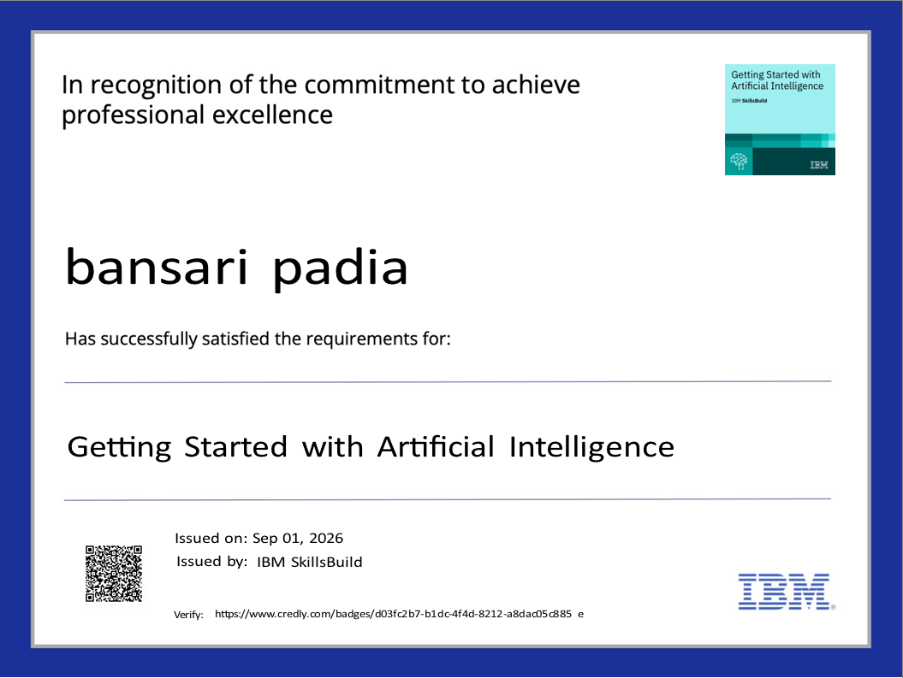
Getting Started with artificial intelligence credly certificate
Certificates Earned:

Slide 66
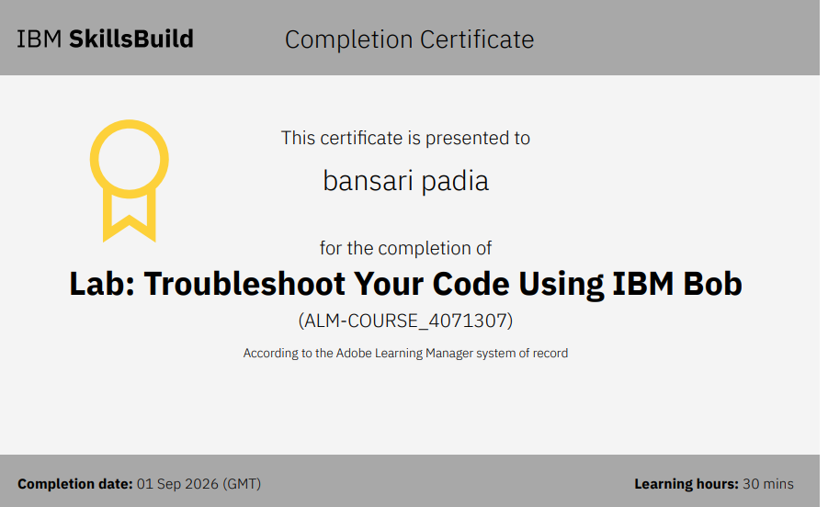
IBM BOB Certificate

Slide 67
Thank you

